Slide 1

Community Physiotherapy & LTCs
London Metropolitan University
Nicole Nielsen
24/03/2025

Slide 2
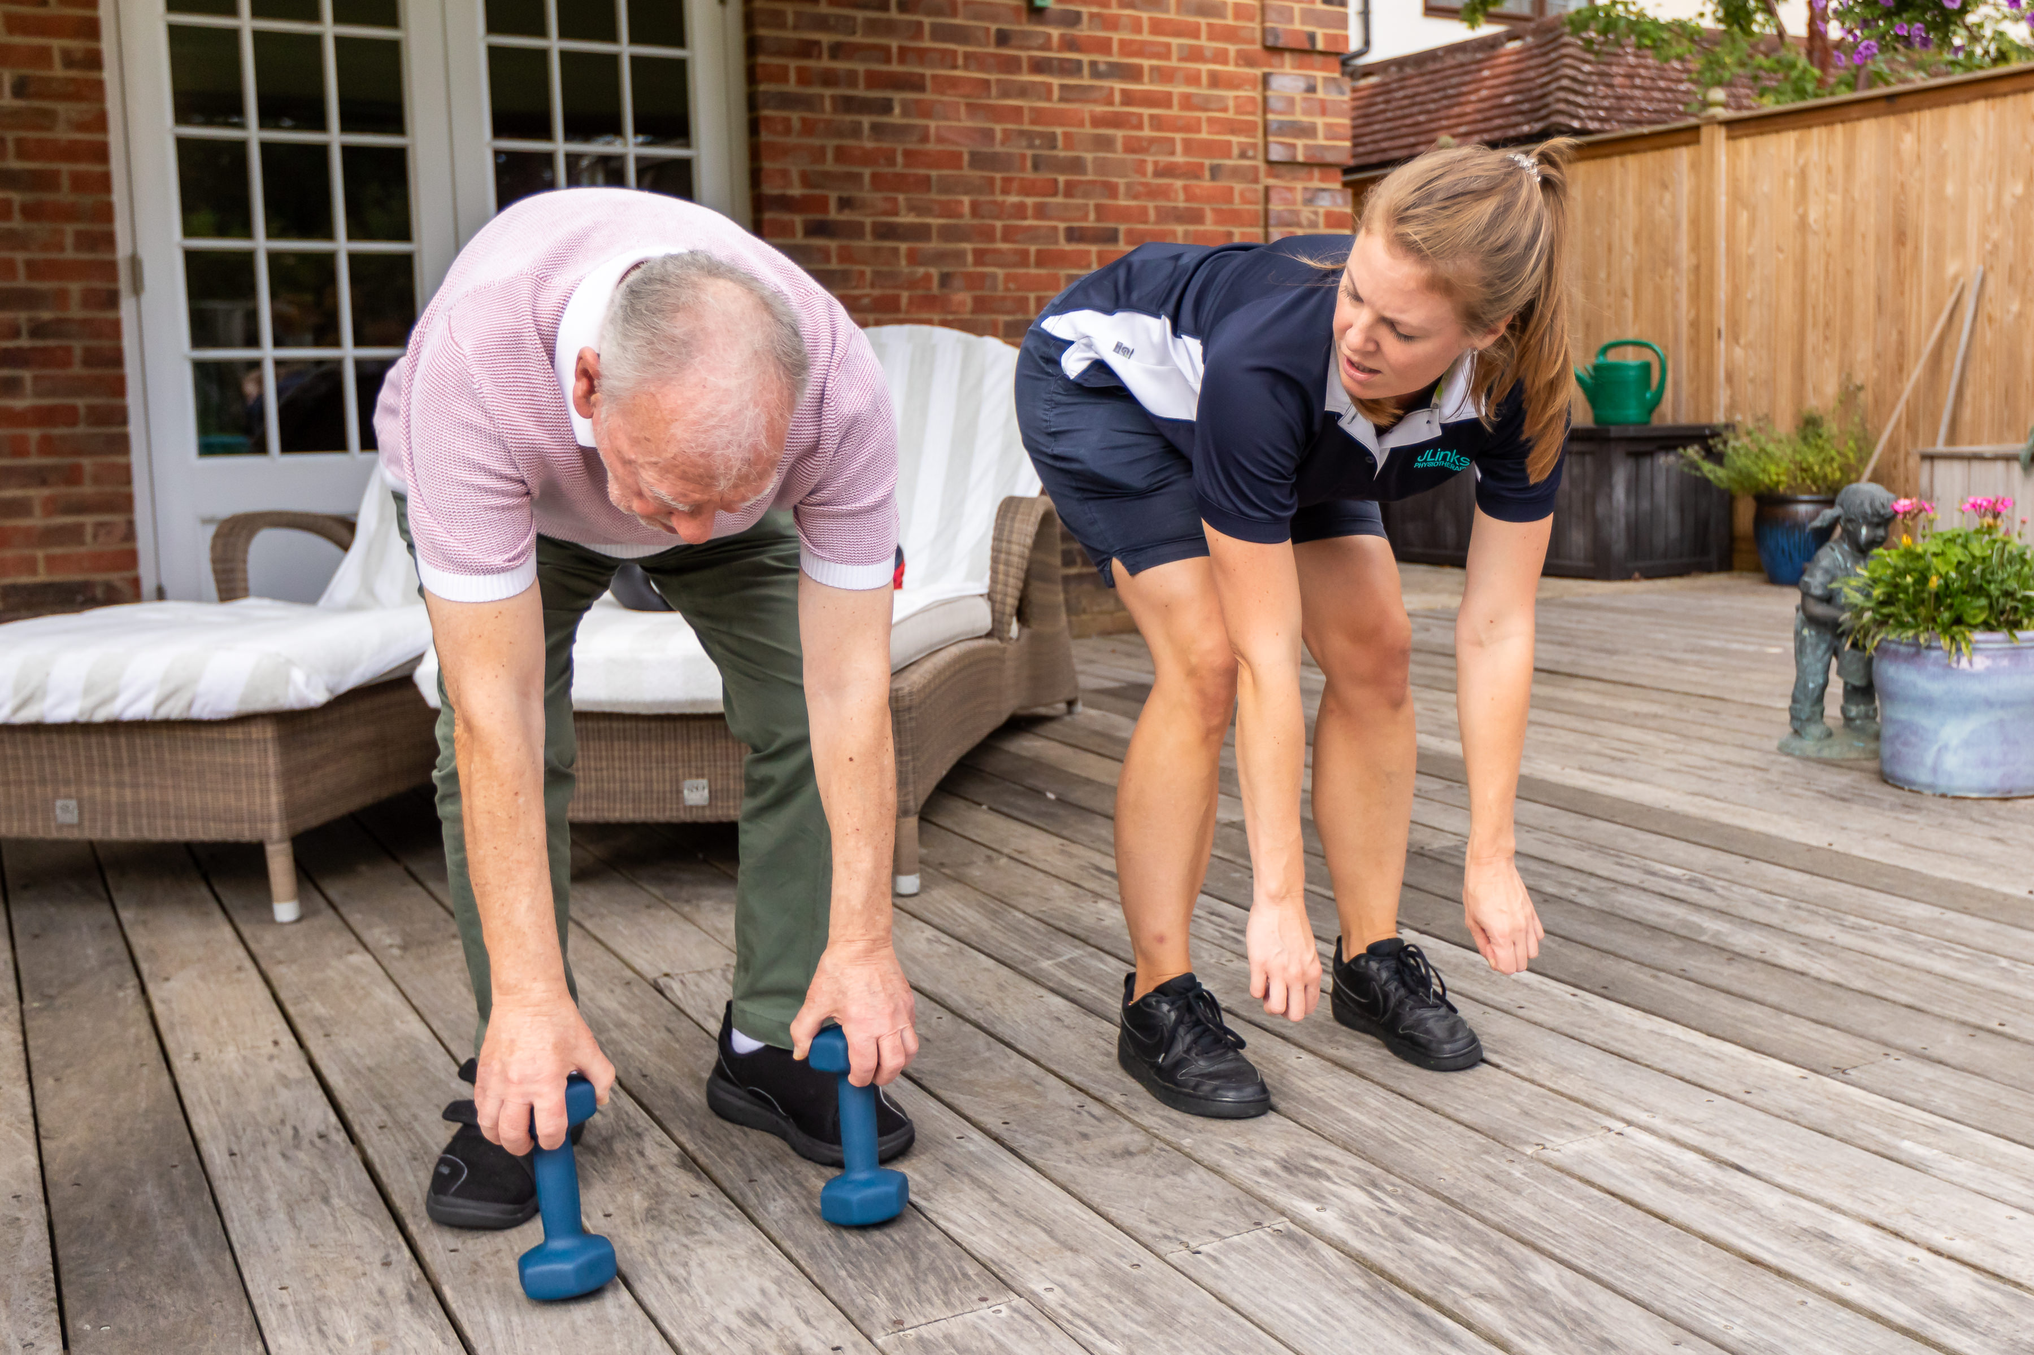
What will today look like?
14:00 – 14:15 Intro
14:15 – 15:00 Theory
15:00 – 15:15 Break
15:15 – 15:30 Case scenarios
15:30 – 16:30 Practical (2x 30 mins break out groups, swap ½ way)
16:30 – 17:00 Final reflections & feedback

Slide 3
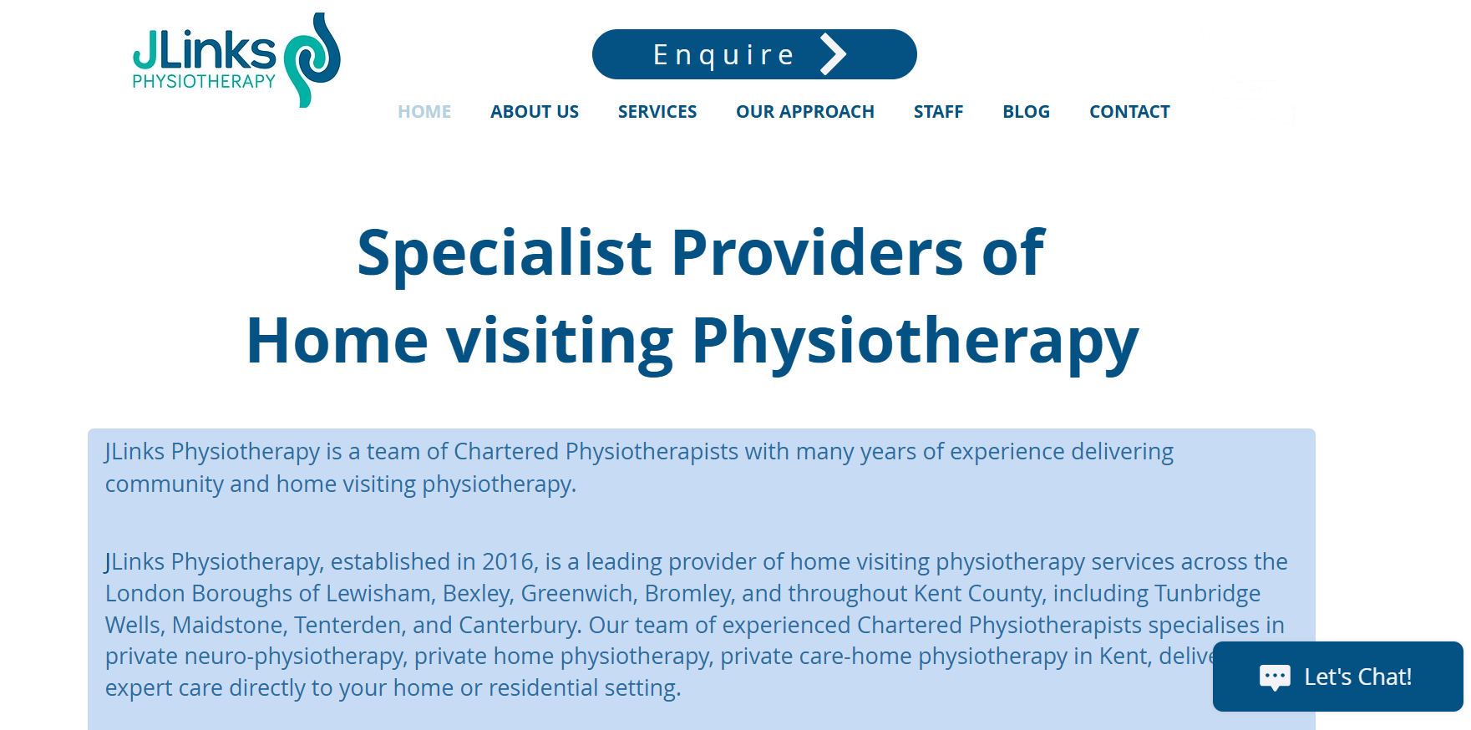
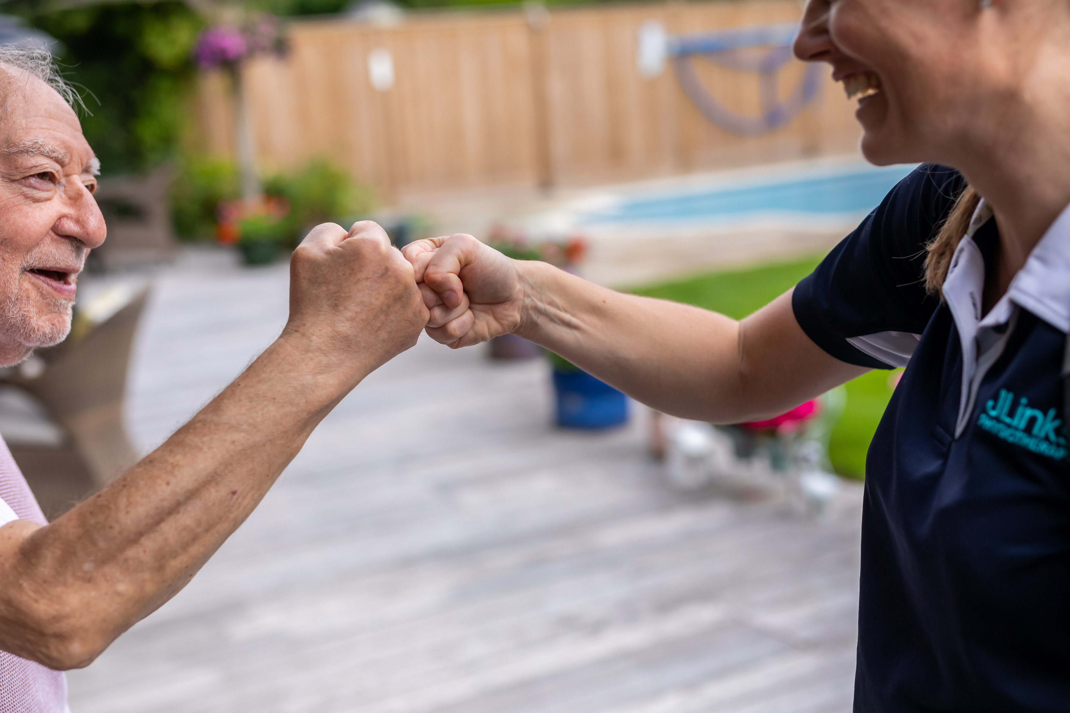
Intro – Who are we?
Home Visit Physiotherapy | London And Kent | JLinks

Slide 4
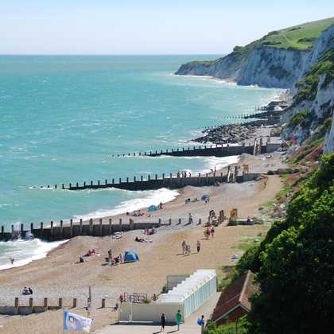
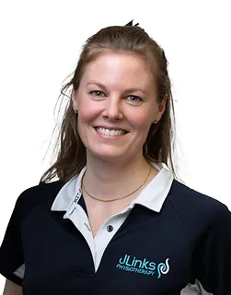

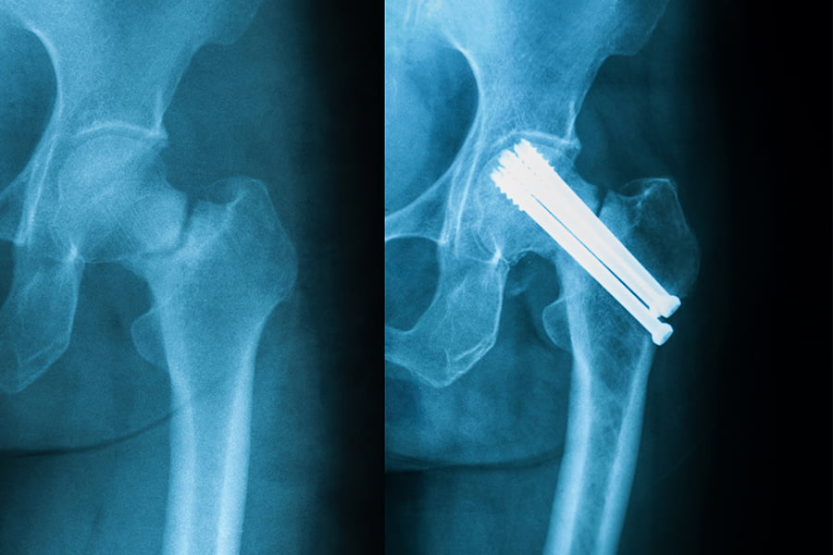
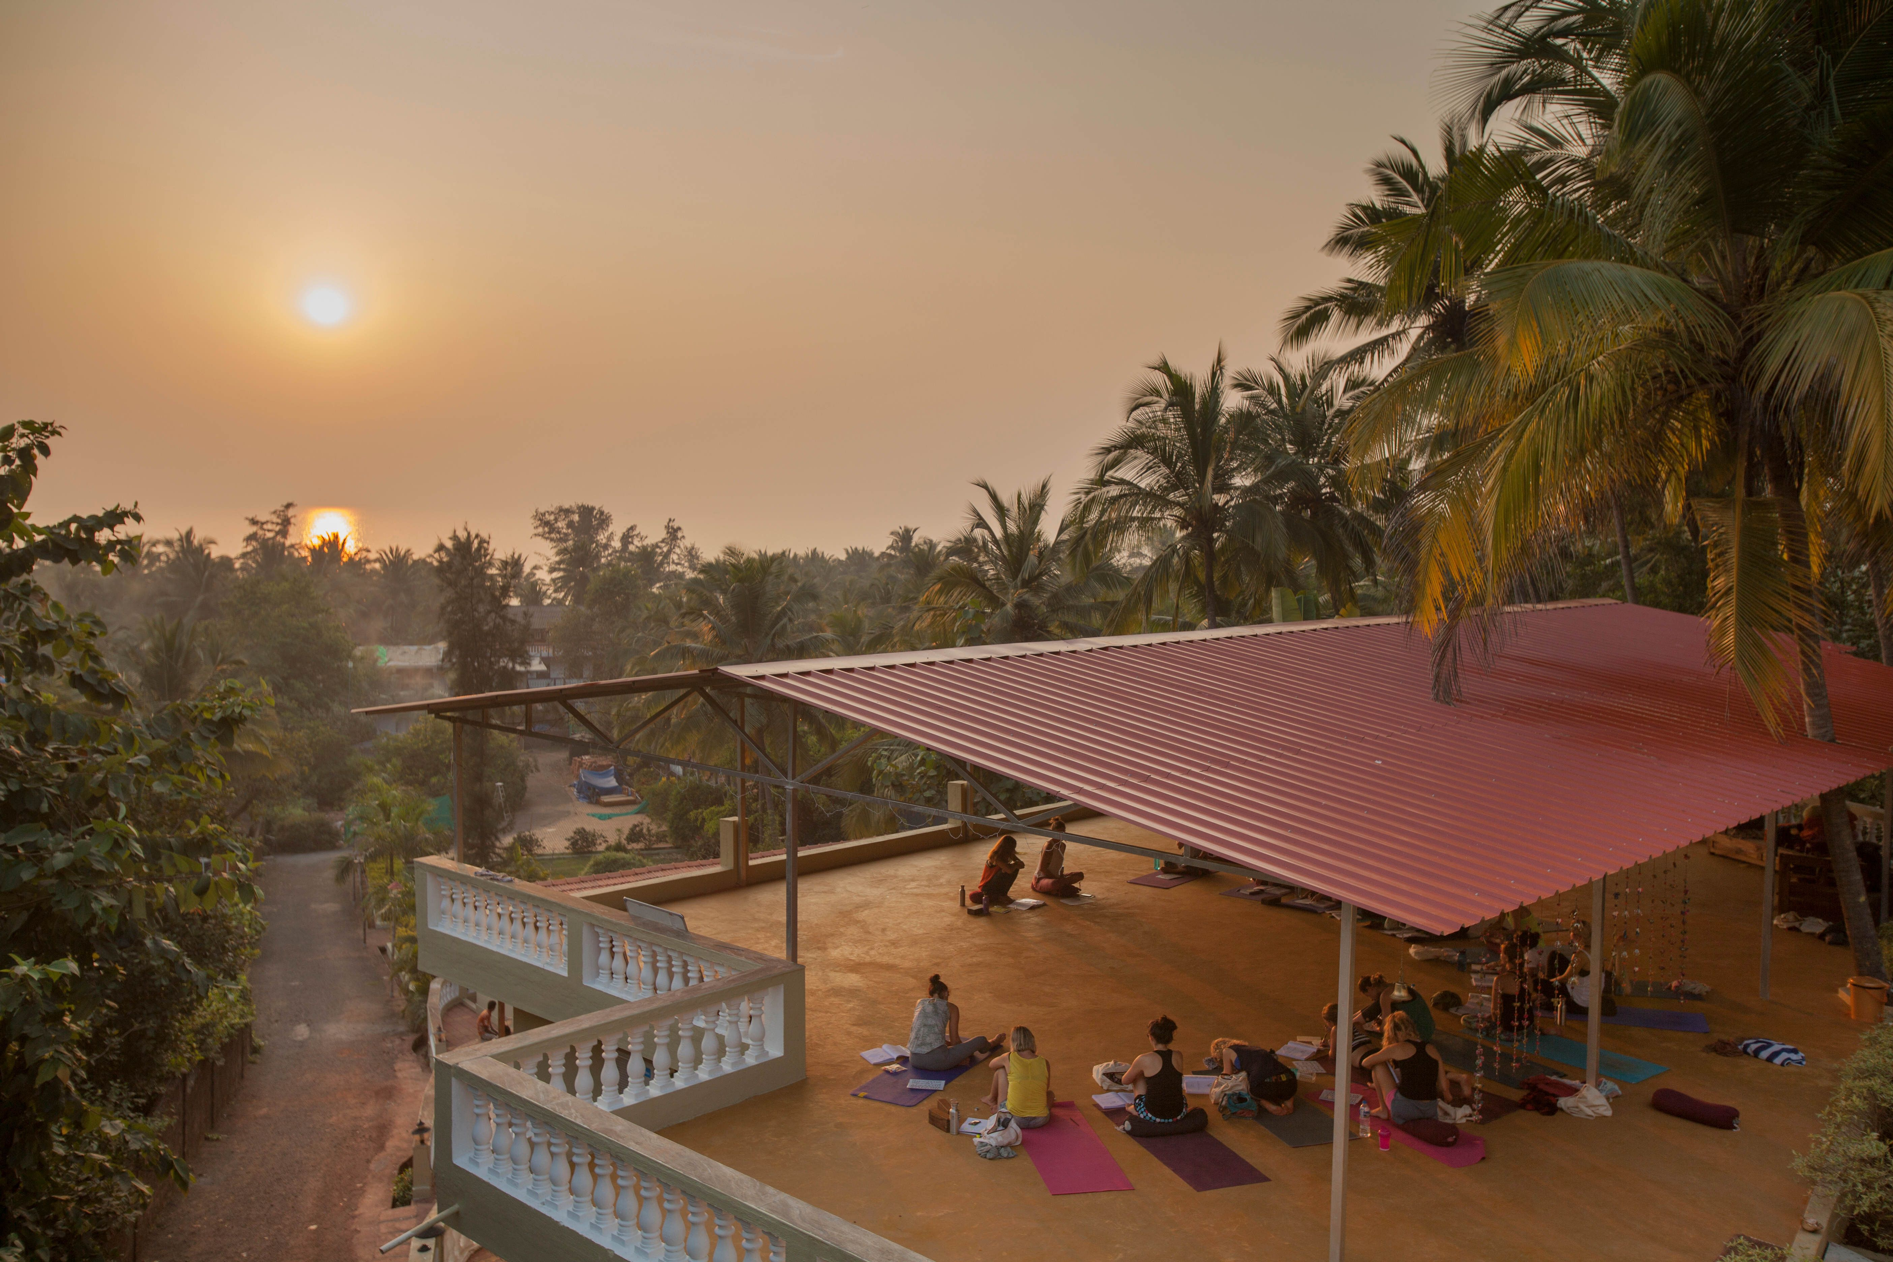
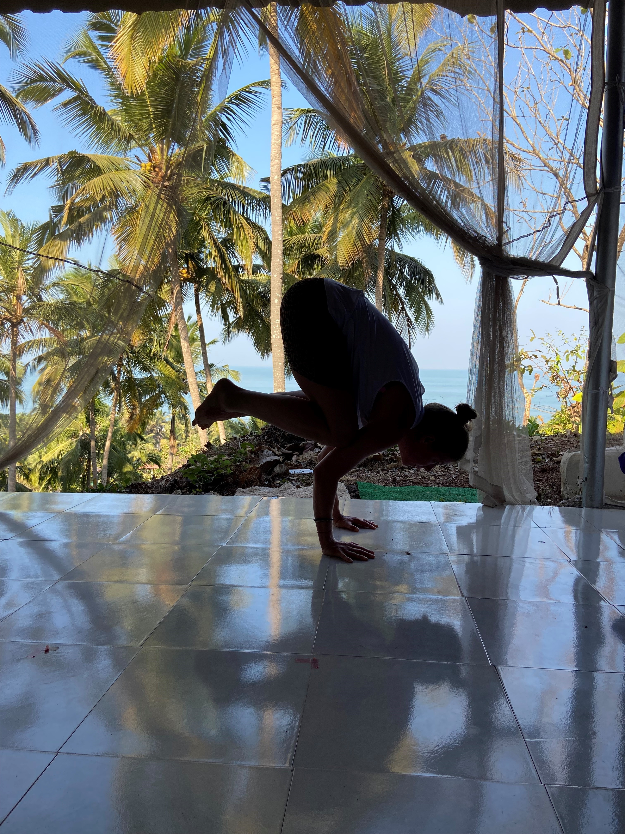

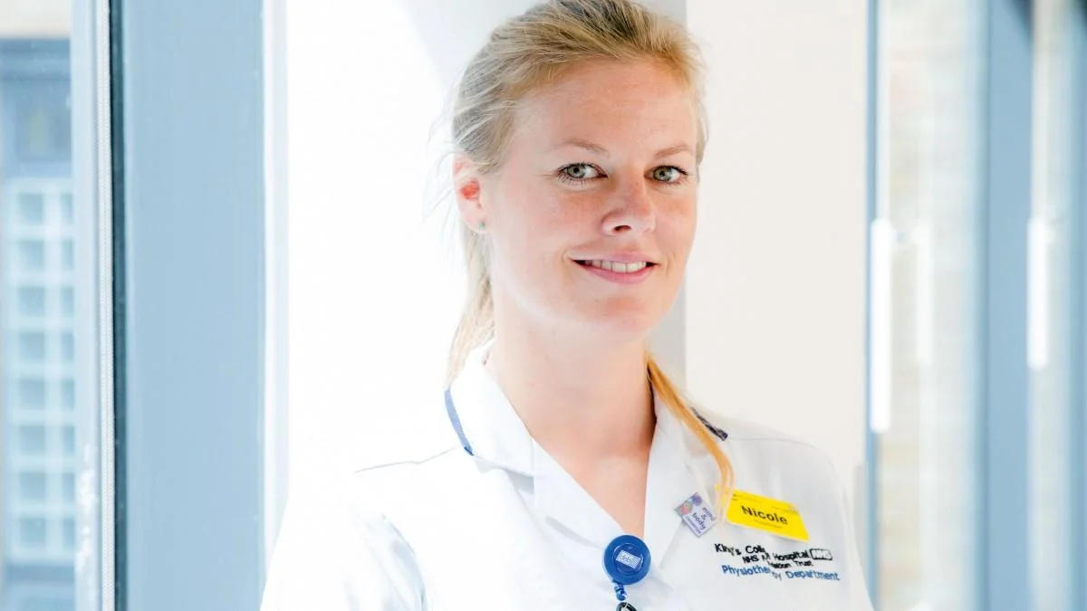
Intro – Who am I?
University of Brighton 2006 - 2009
Nicole Nielsen
Clinical Specialist Physiotherapist & Operations Manager
Nicole@jlinks.co.uk
2020
YTT Goa, India
2023
B5 – B7
2009 - 2023

Slide 5
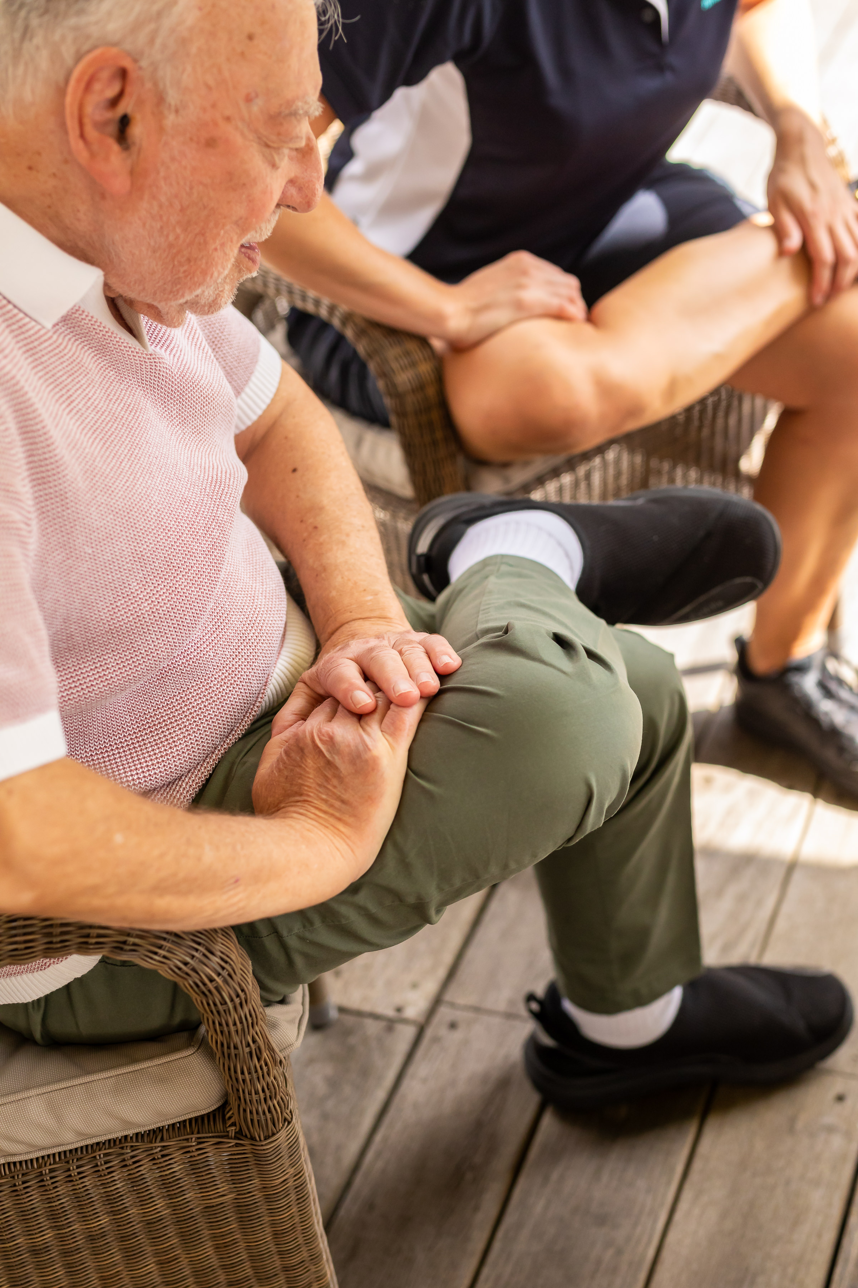
Learning Objectives
To have an understanding of what community physiotherapy is & why it’s important in current health strategies
To understand what a LTC is & the role of the community physiotherapist in this patient group
To understand what a community physiotherapy assessment (subjective & objective) might include, adapting skills from the hospital/clinic setting
To consider a problem list for a LTC patient in the community, recognising priorities & have awareness of how to manage this, including awareness of the MDT

Slide 6
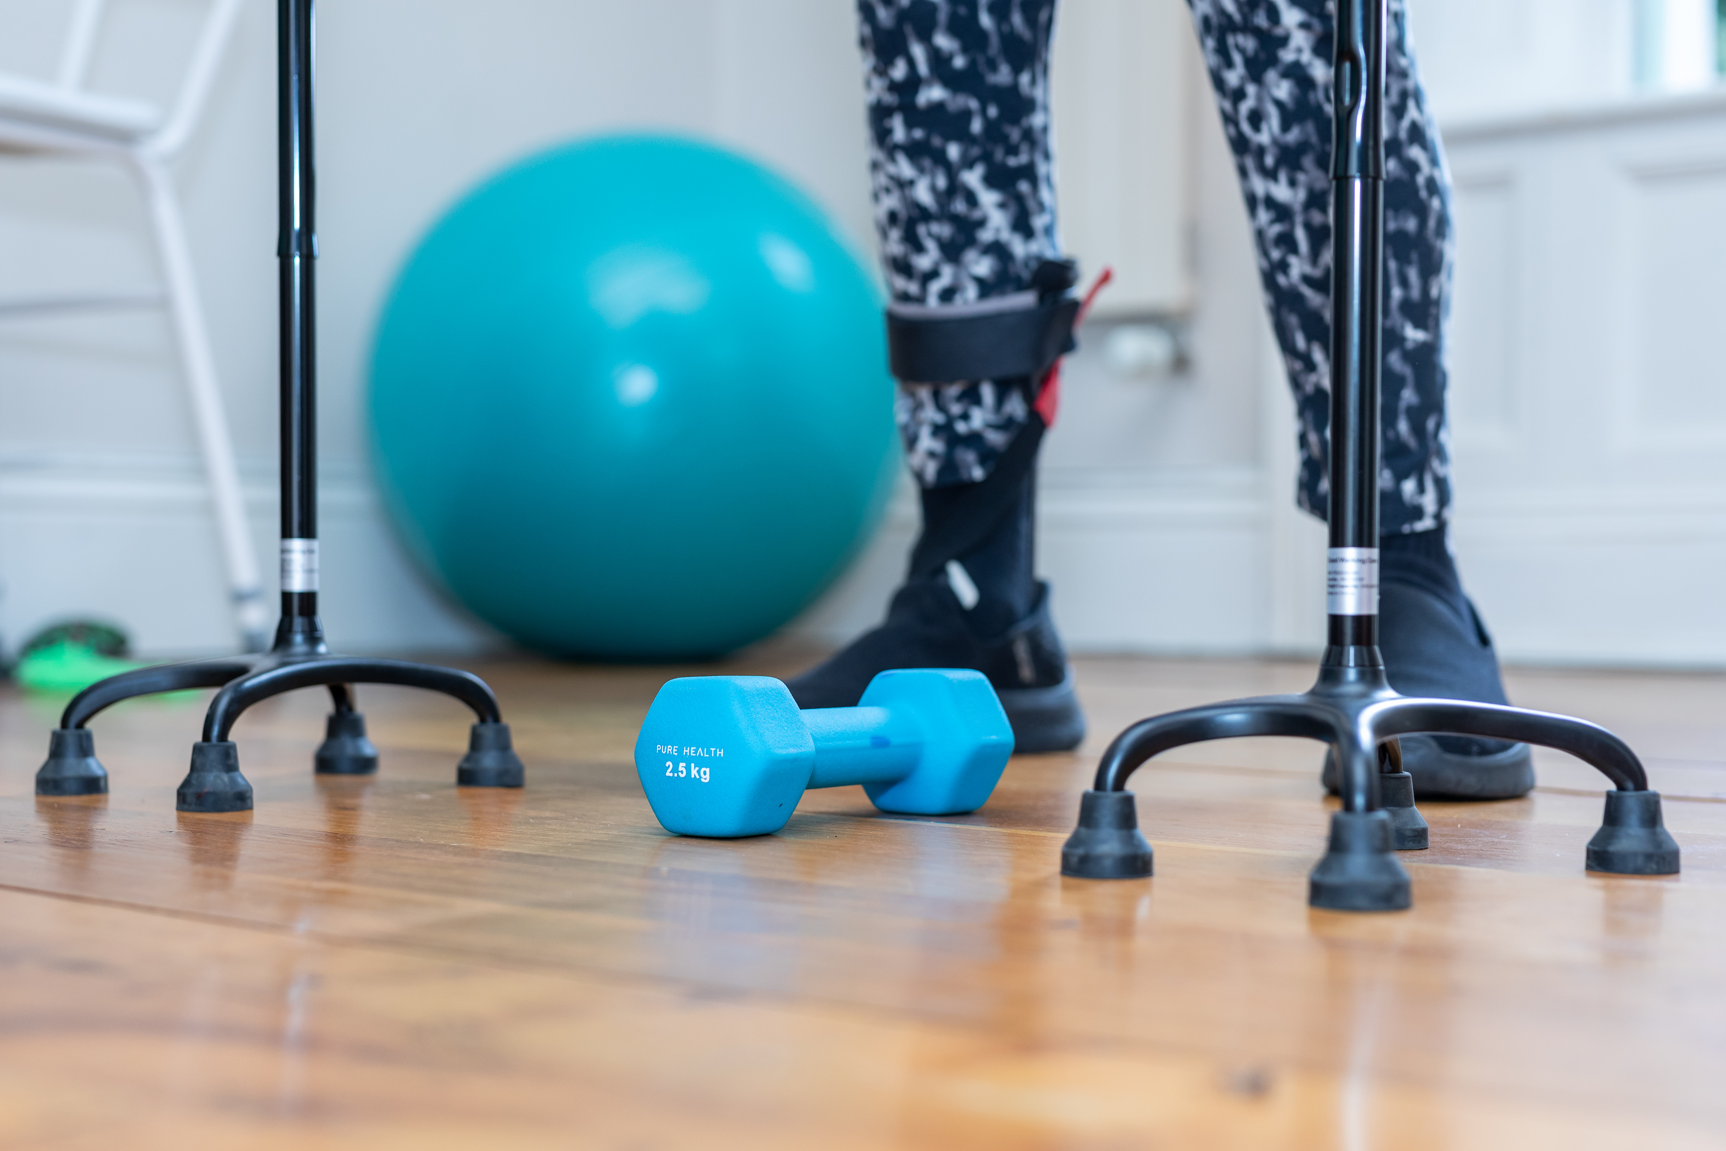
Community Physiotherapy
What is it?
Who needs it?
What “speciality/ies” does it include?
What does it mean to be a community physiotherapist?

Slide 7
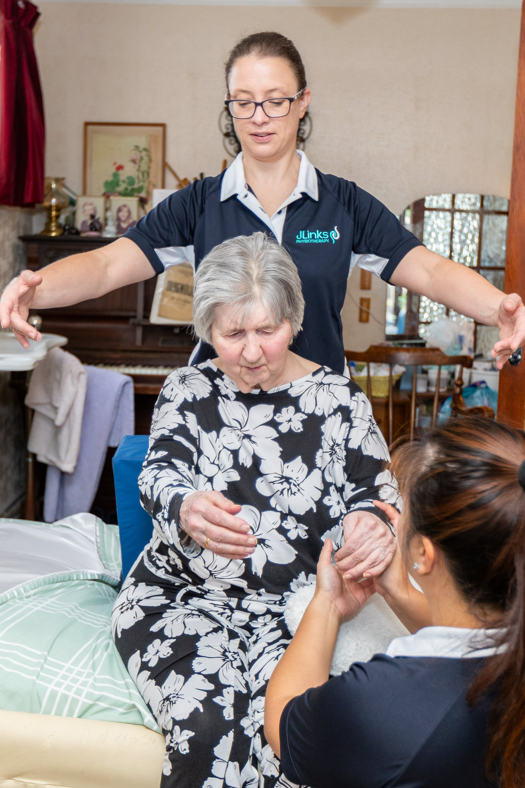
Community Rehabilitation
Community rehabilitation should be focused on maximising and maintaining independence and thereby reduce the overall burden on the healthcare system.
(NICE guideline Emergency and acute medical care in over 16s: service delivery and organisation, March 2018)

Slide 8
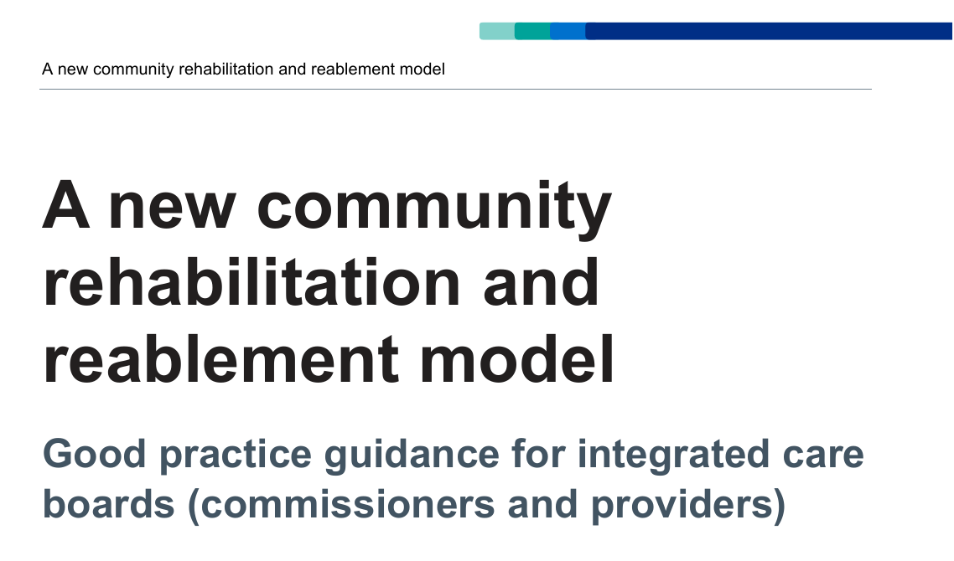

(CRA 2025)
(NHS England 2023)

Slide 9
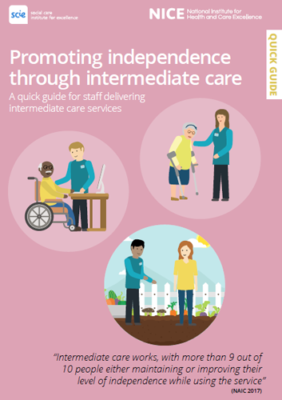
Intermediate Care
Time limited, short term (ca 6/52) health and/or social care provided to adults who need support after D/C from acute and virtual wards to support rehab, reablement and recovery.
Can be entirely health, entirely social care, or (ideally) an integrated service of both. They may be commissioned by the NHS and/or Local Authorities and delivered by providers across health, social care, housing, independent and voluntary sectors.
(CSP 2025)

Slide 10
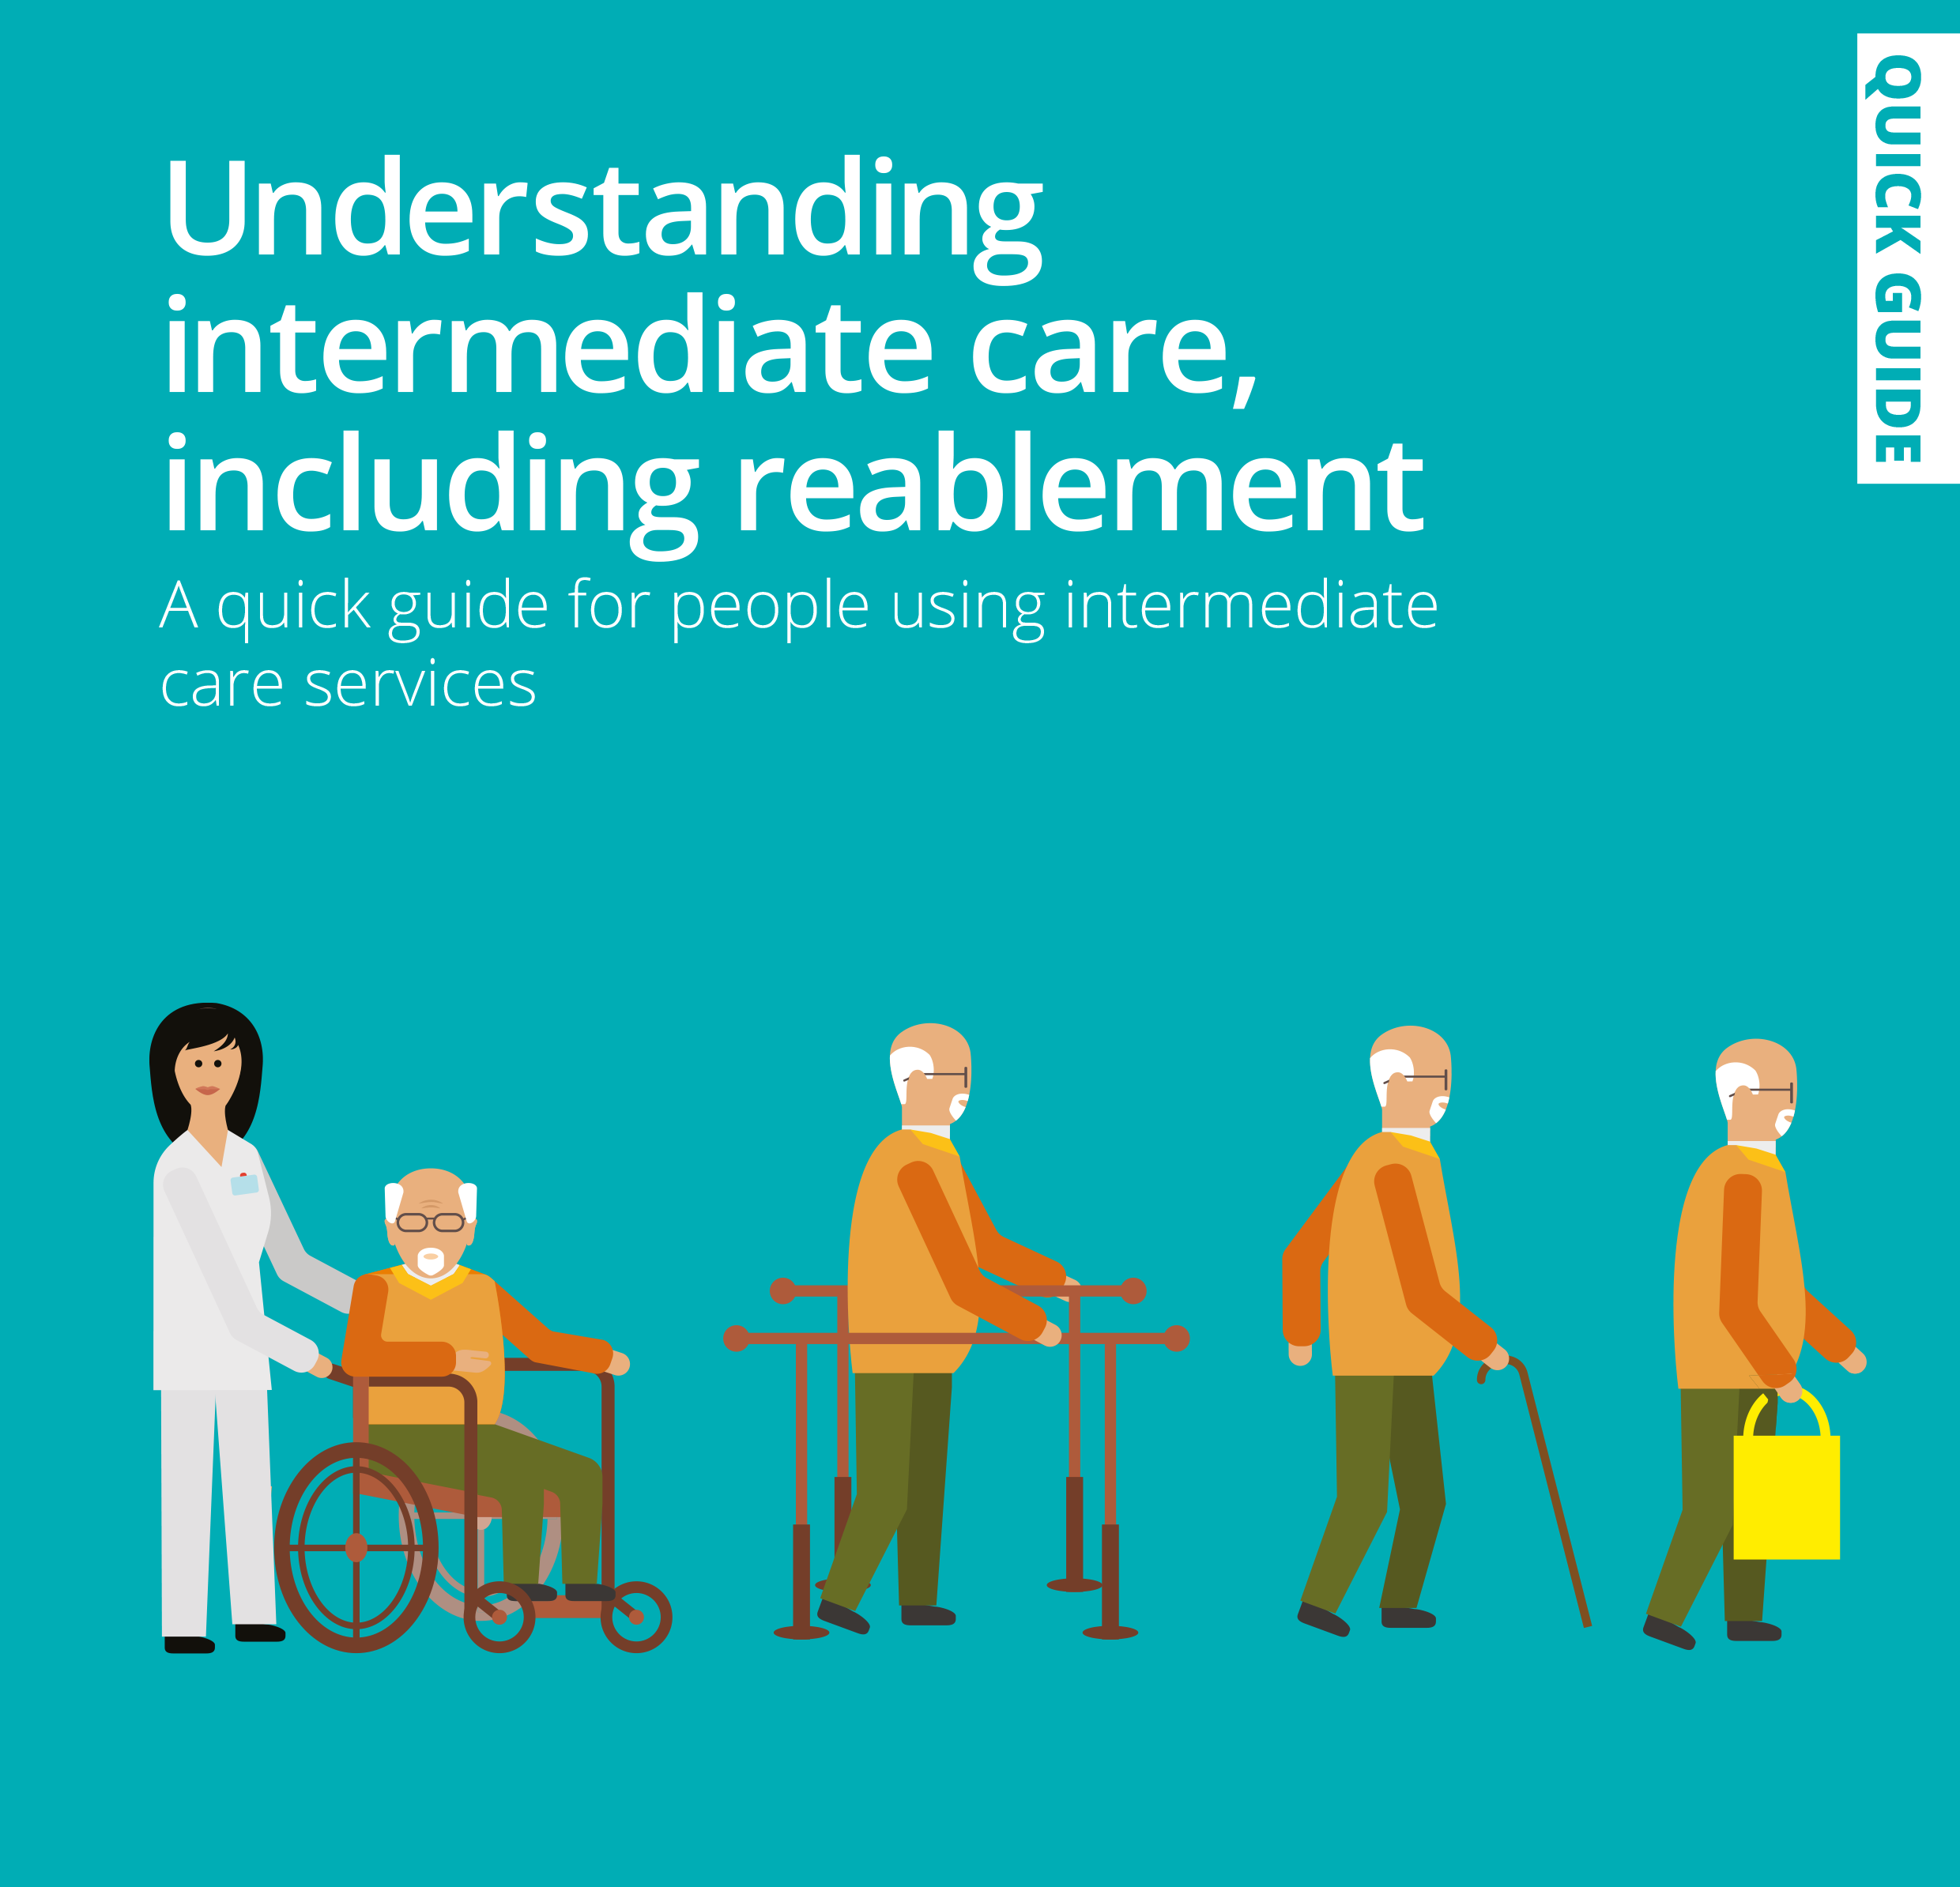
Intermediate Care Framework
best practice guidance
recommended actions for improving step down intermediate care
using a new therapy-led community rehab model of care
part of the Urgent & Emergency Care recovery plan
(CSP 2025)

Slide 11
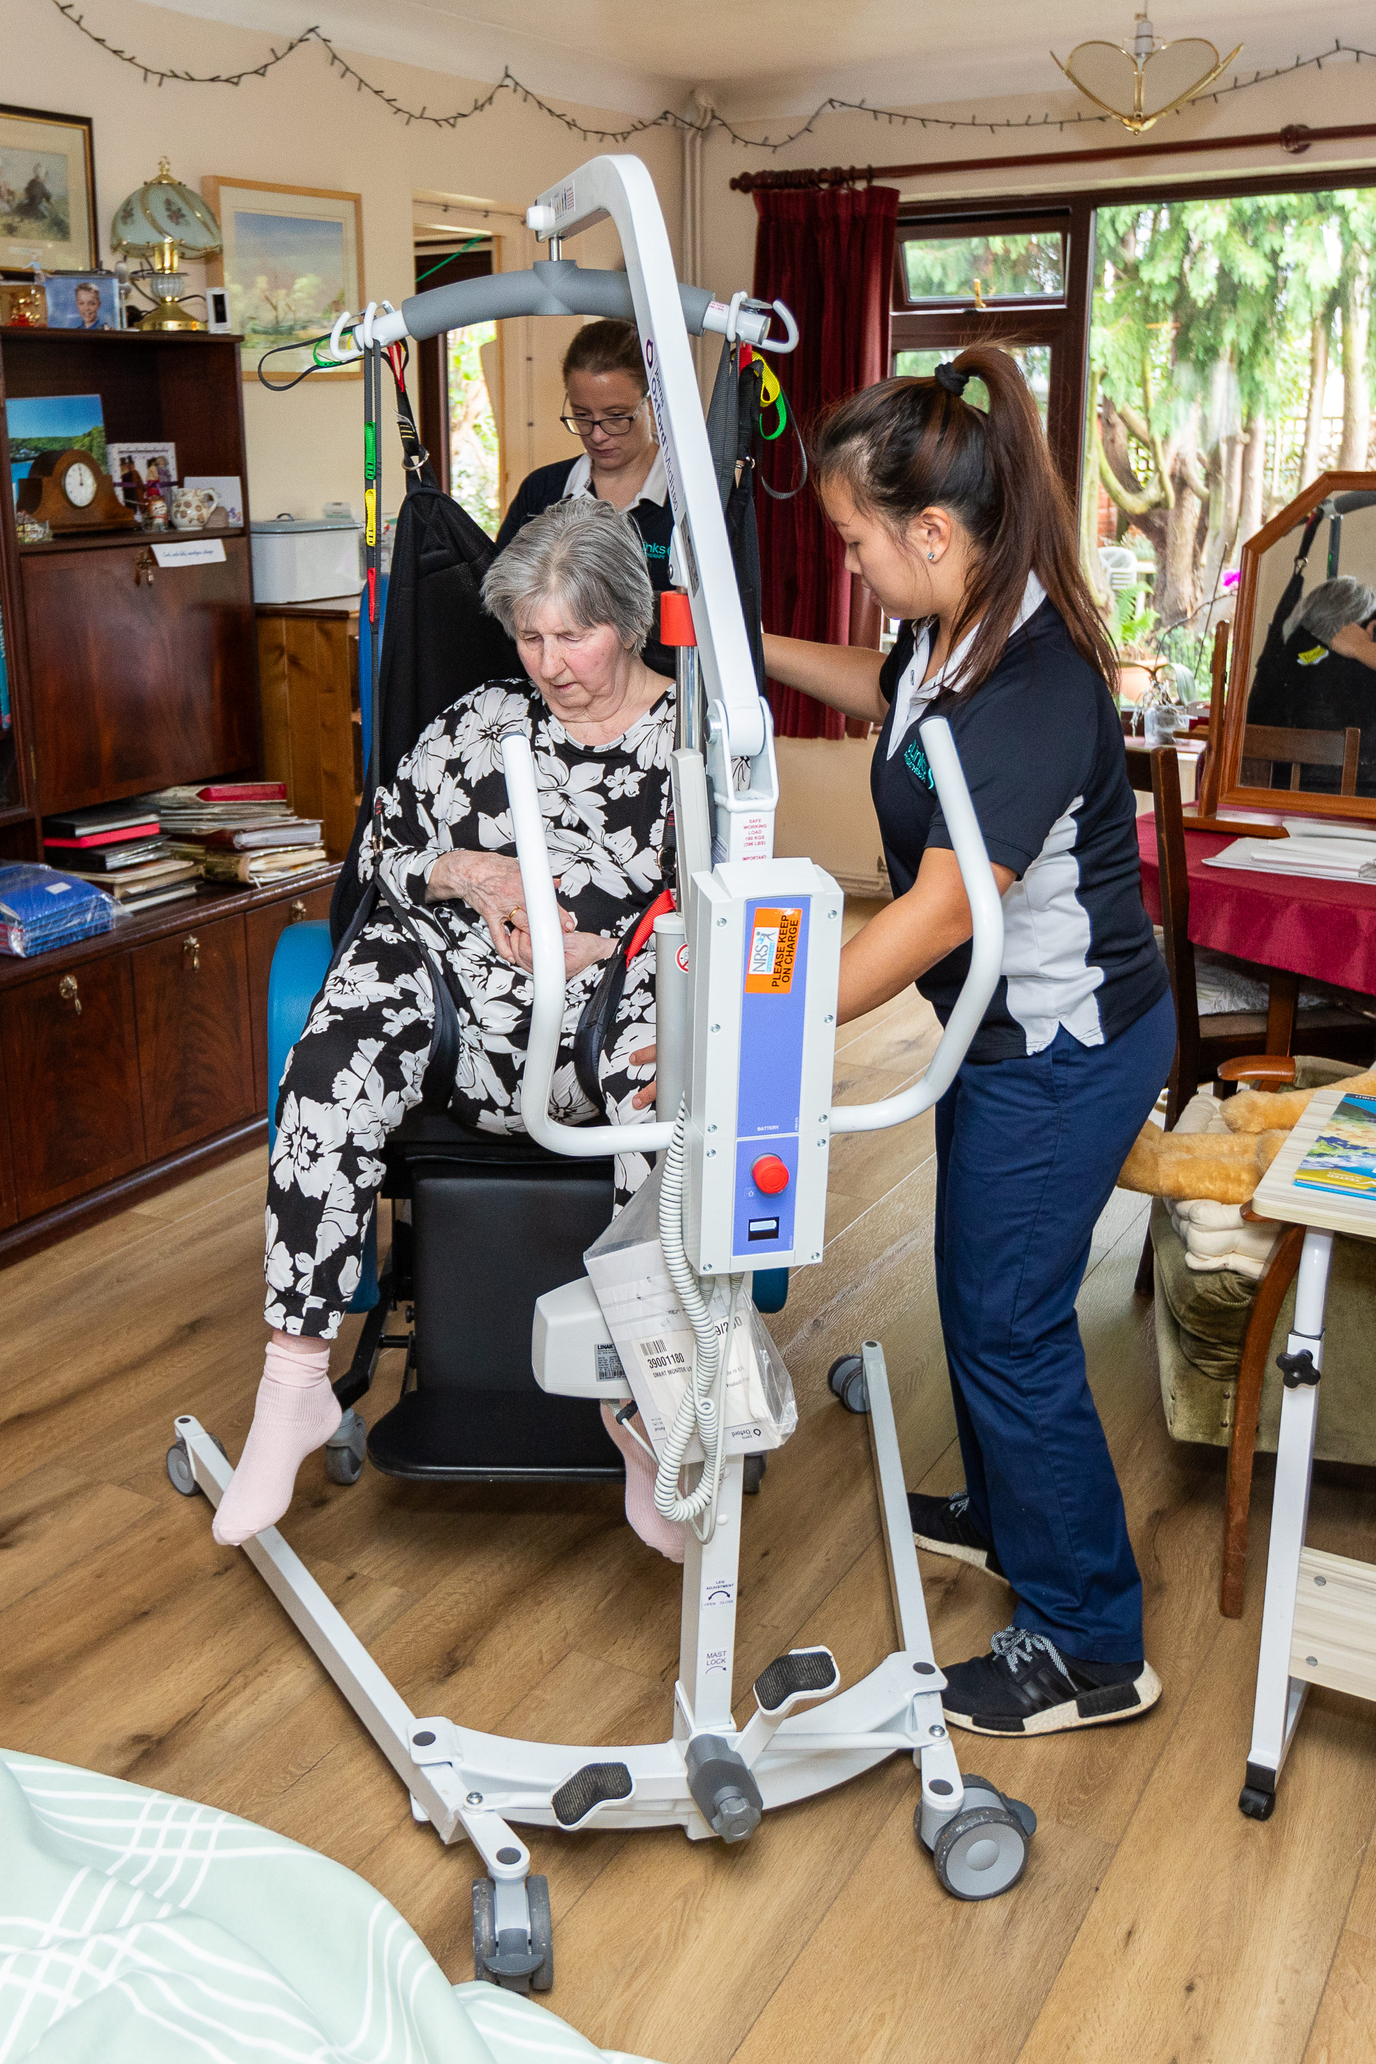
Intermediate Care Framework Aims
Improve people’s outcomes and experience of hospital D/C
Reduce hospital re-admissions
Reduce avoidable/ premature long term care provision
Improved patient flow and D/C from hospital settings
Develop a new national standard for D/C, by improving and standardising community rehab data.
(CSP 2025)

Slide 12
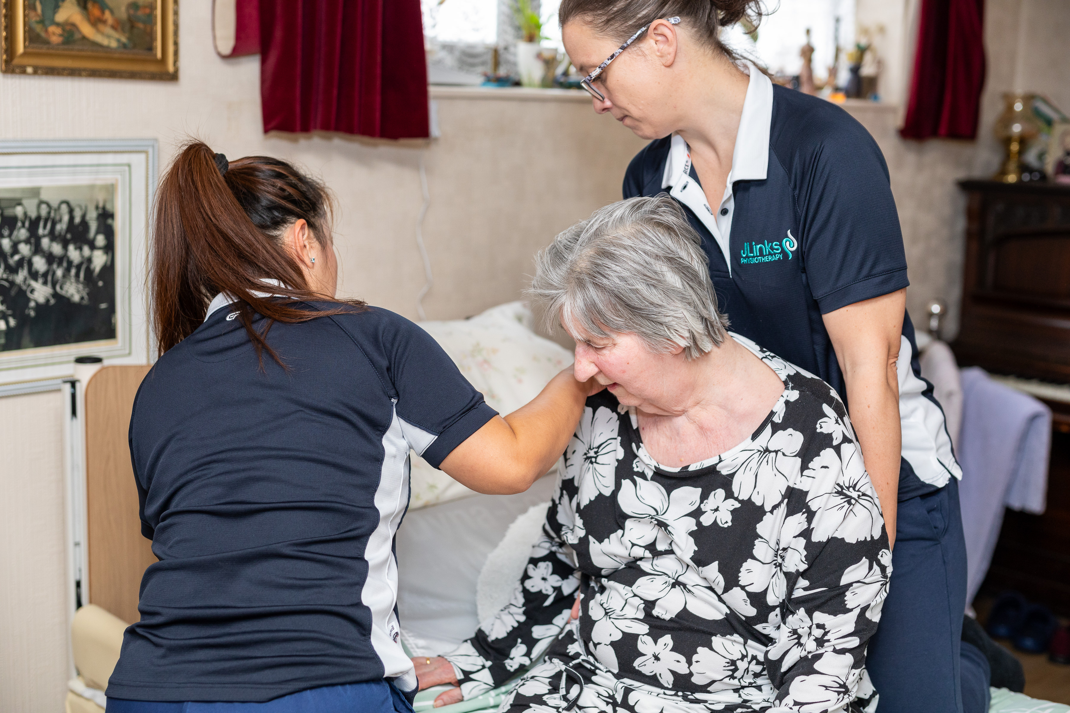
Intermediate Care Framework Pathways
Pathway 0 – community-based assessment of need
Pathway 1 – community-based assessment, home based therapy led interventions.
Pathway 2 – assessment of needs, move to short term bedded care (may be followed by pathway 1)
(CSP 2025)

Slide 13
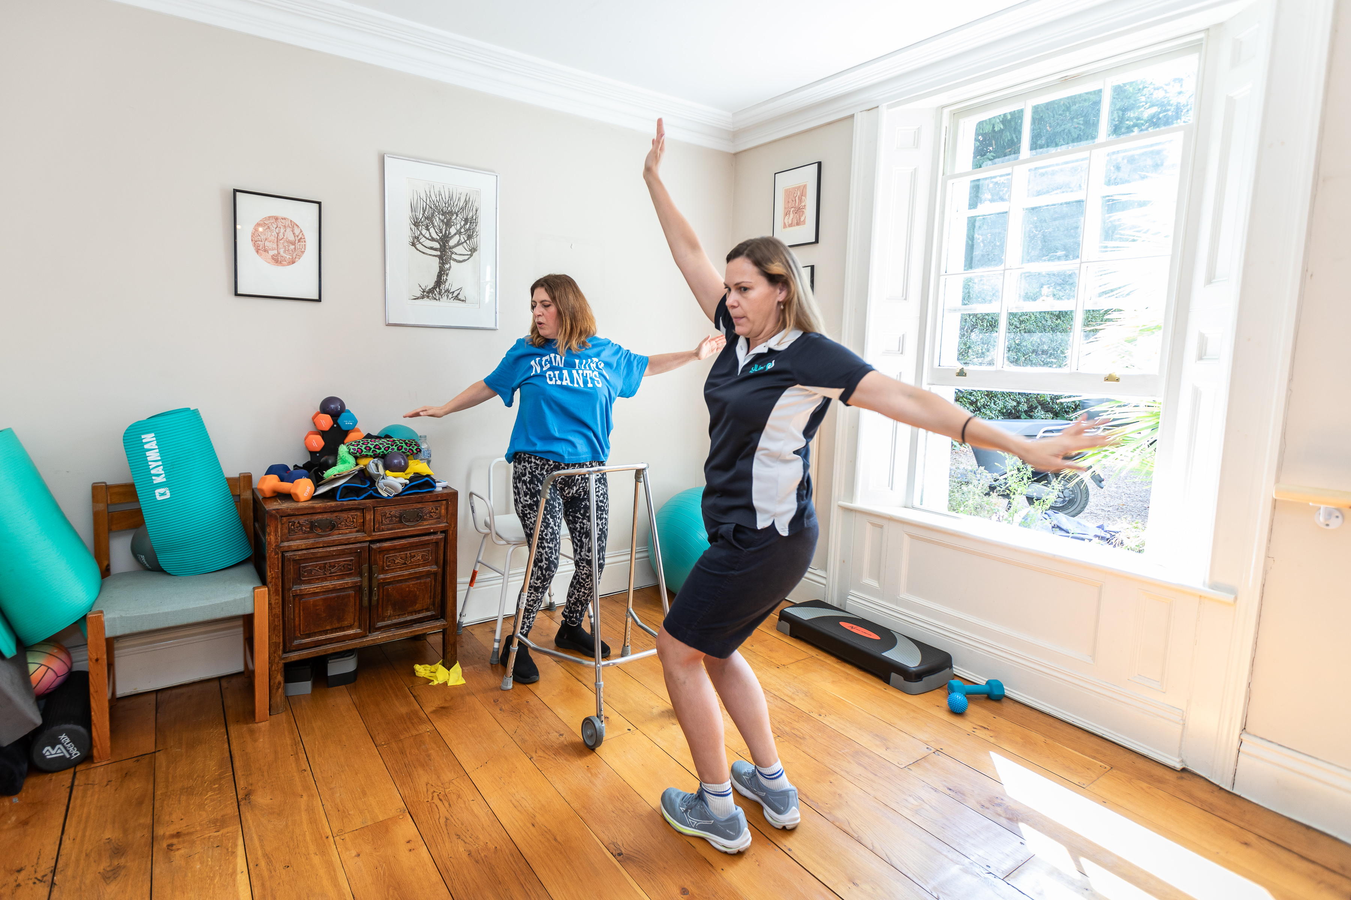
Intermediate Care Framework Outcome (if implemented)
improve rehab offer for 100s of 1000s of frail & elderly people currently being let down by the system & denied the opportunity to regain their independence after being in hospital
(CSP 2025)

Slide 14
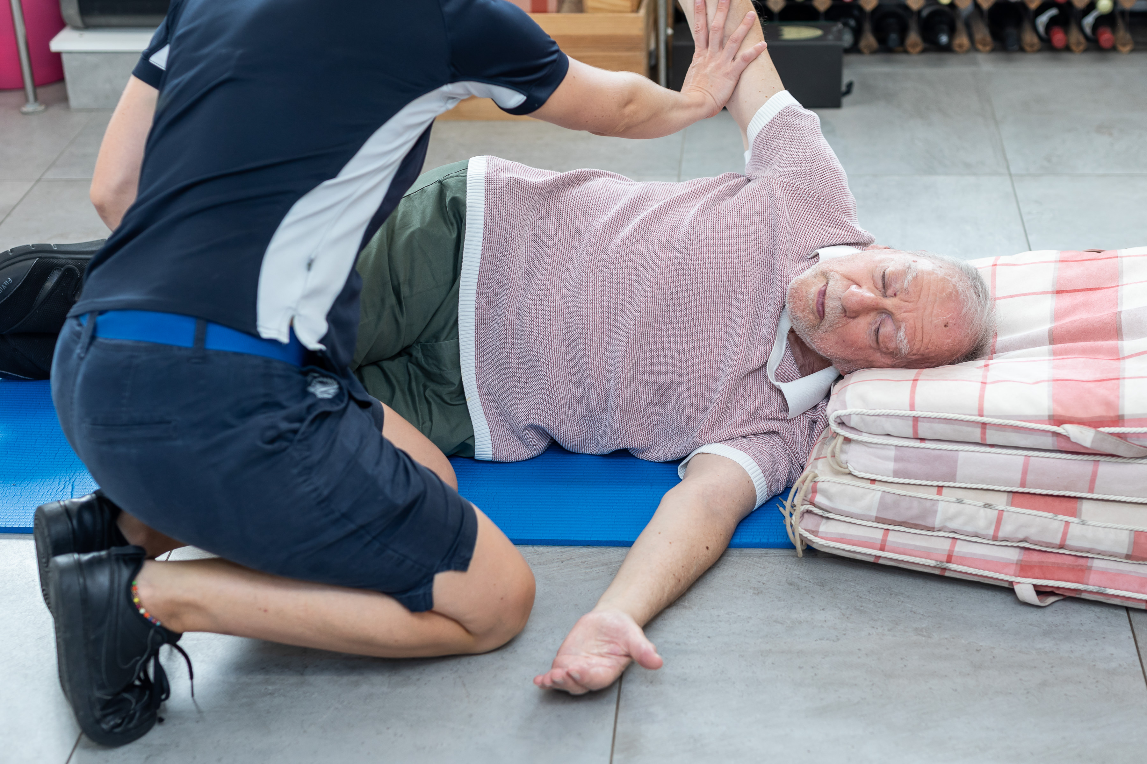
Cont’d…
2) improve provision of rehabilitation more broadly:
    making intermediate care part of the Urgent & Emergency Care Recovery Plan has pushed community rehab to the top of the policy agenda.
    provide system levels leadership and strategic accountability for rehab.
    result in realistic Ax of staffing requirements & help grow the rehab workforce & see this featuring in workforce strategies and People Plans, with governance at the highest level for this. (CSP 2025)

Slide 15
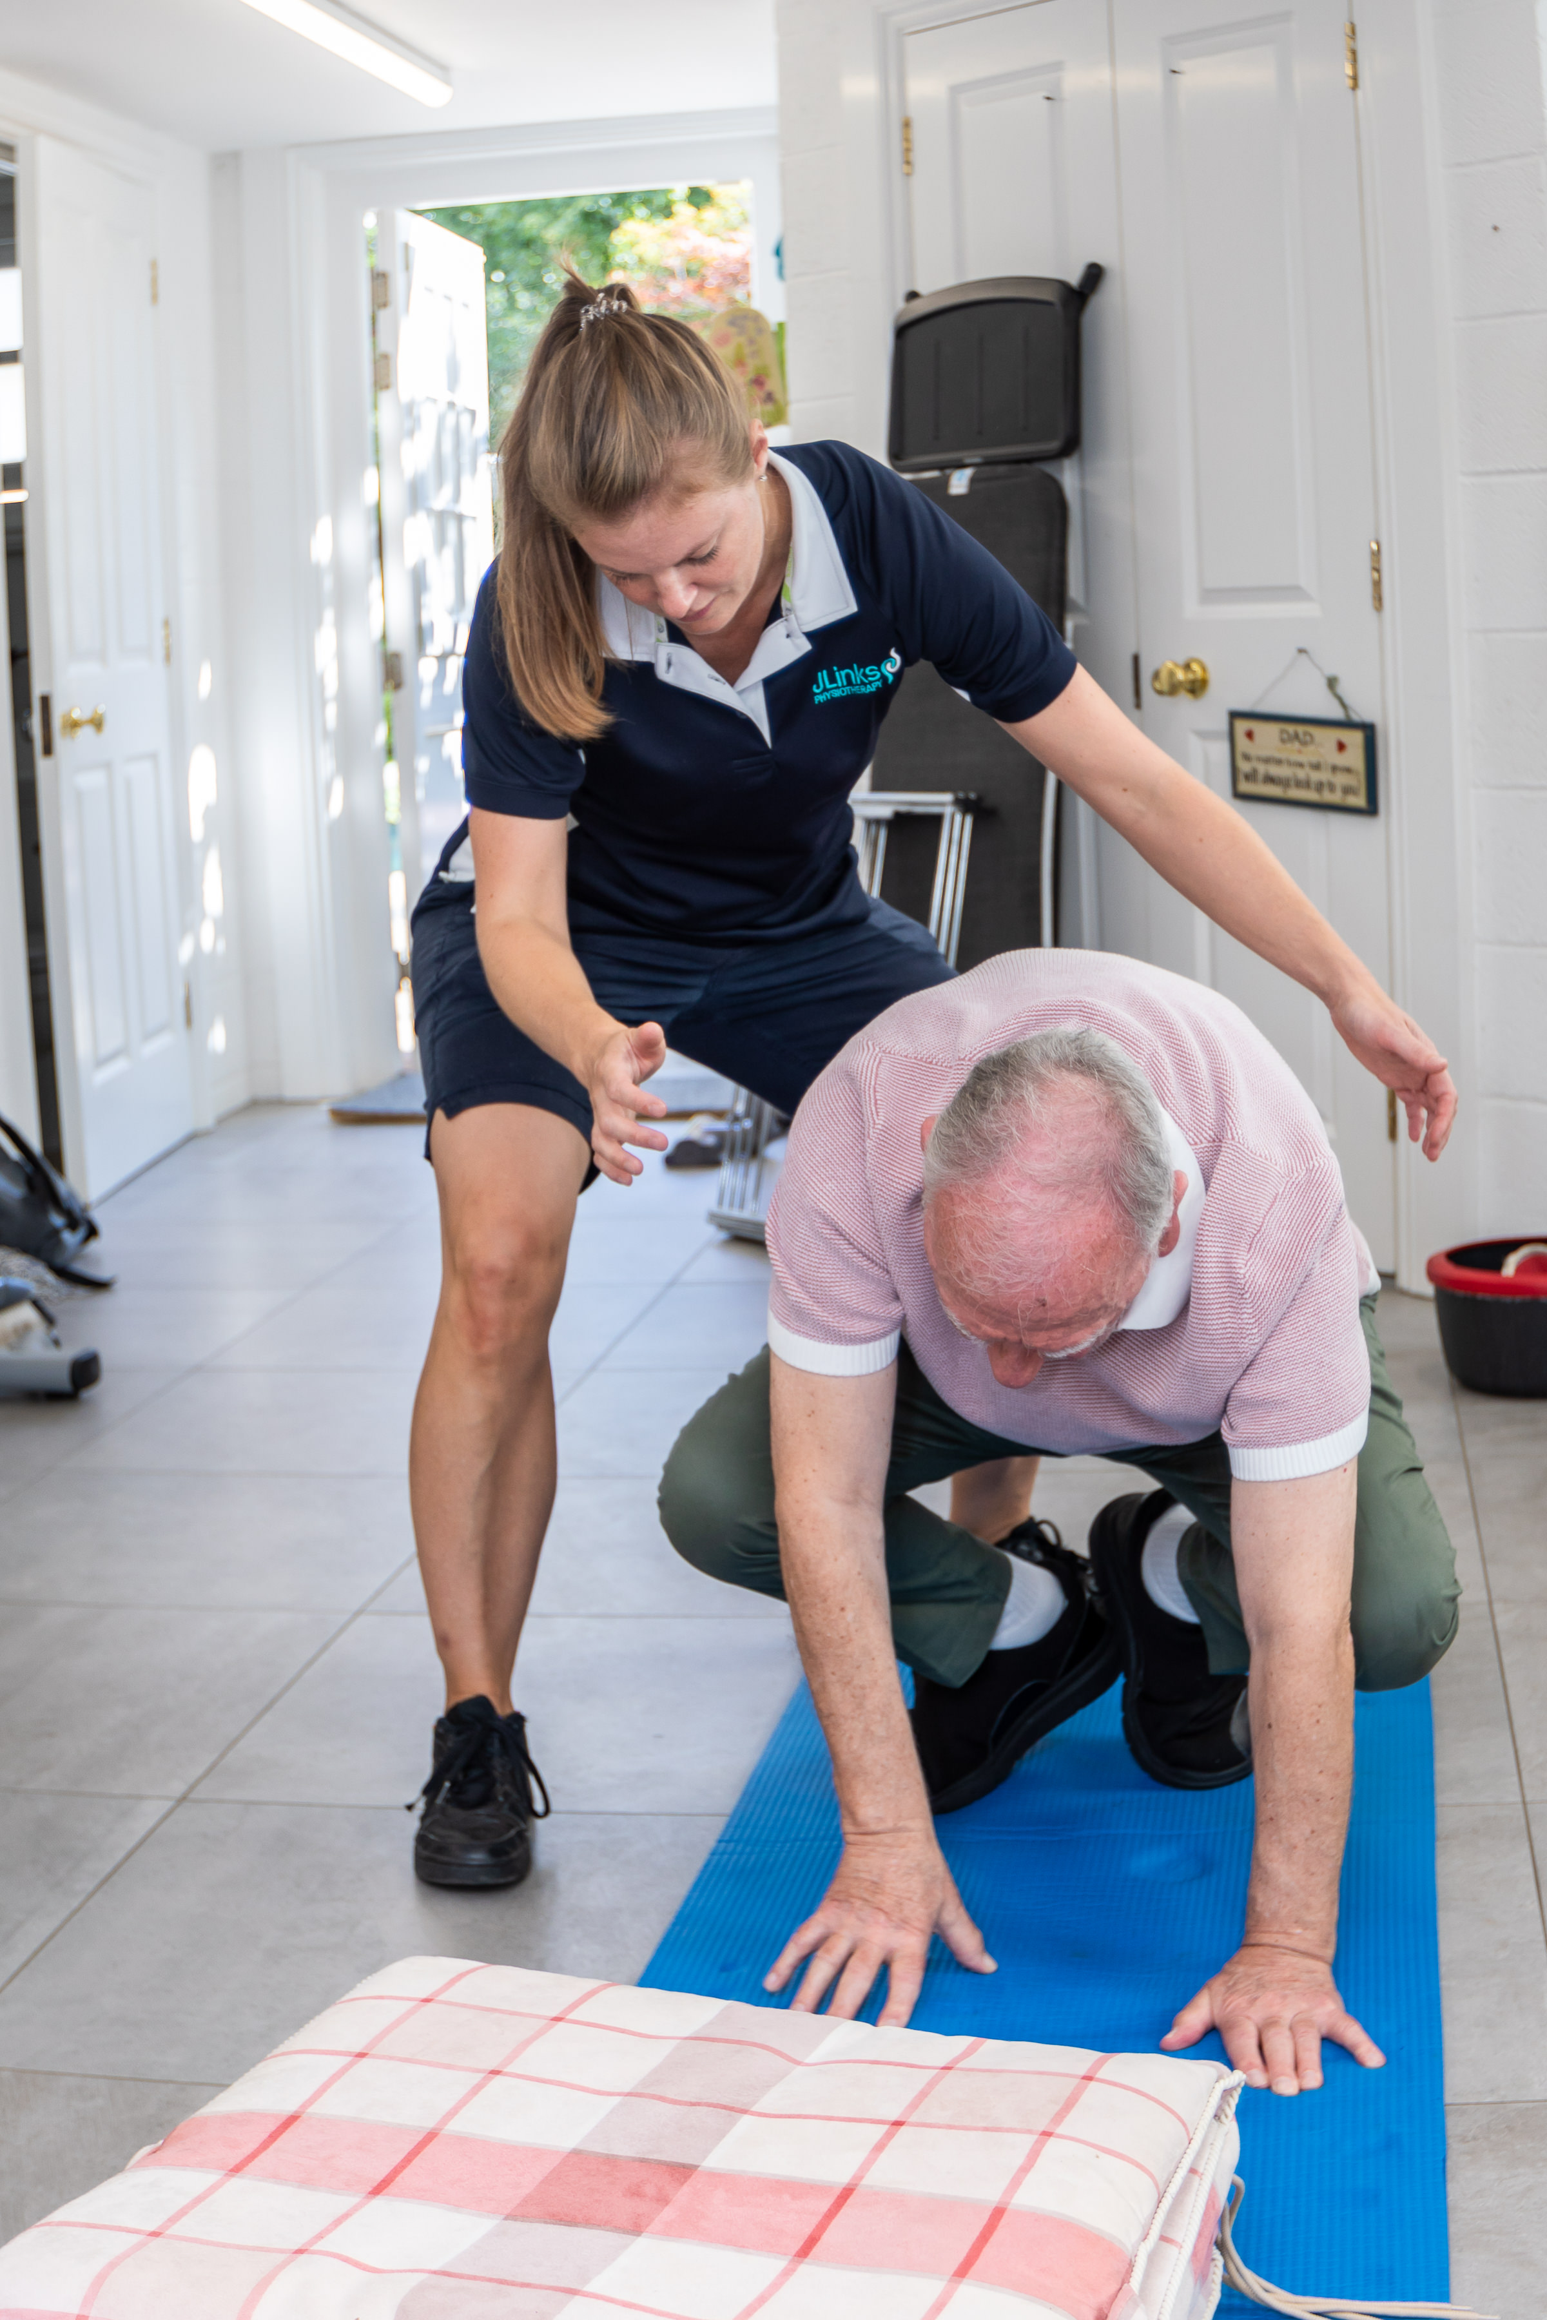
Cont’d…
3) provide data infrastructure that will make visible the value of rehab in terms of outcomes & savings, & the scale of rehab needs.
(CSP 2025)

Slide 16
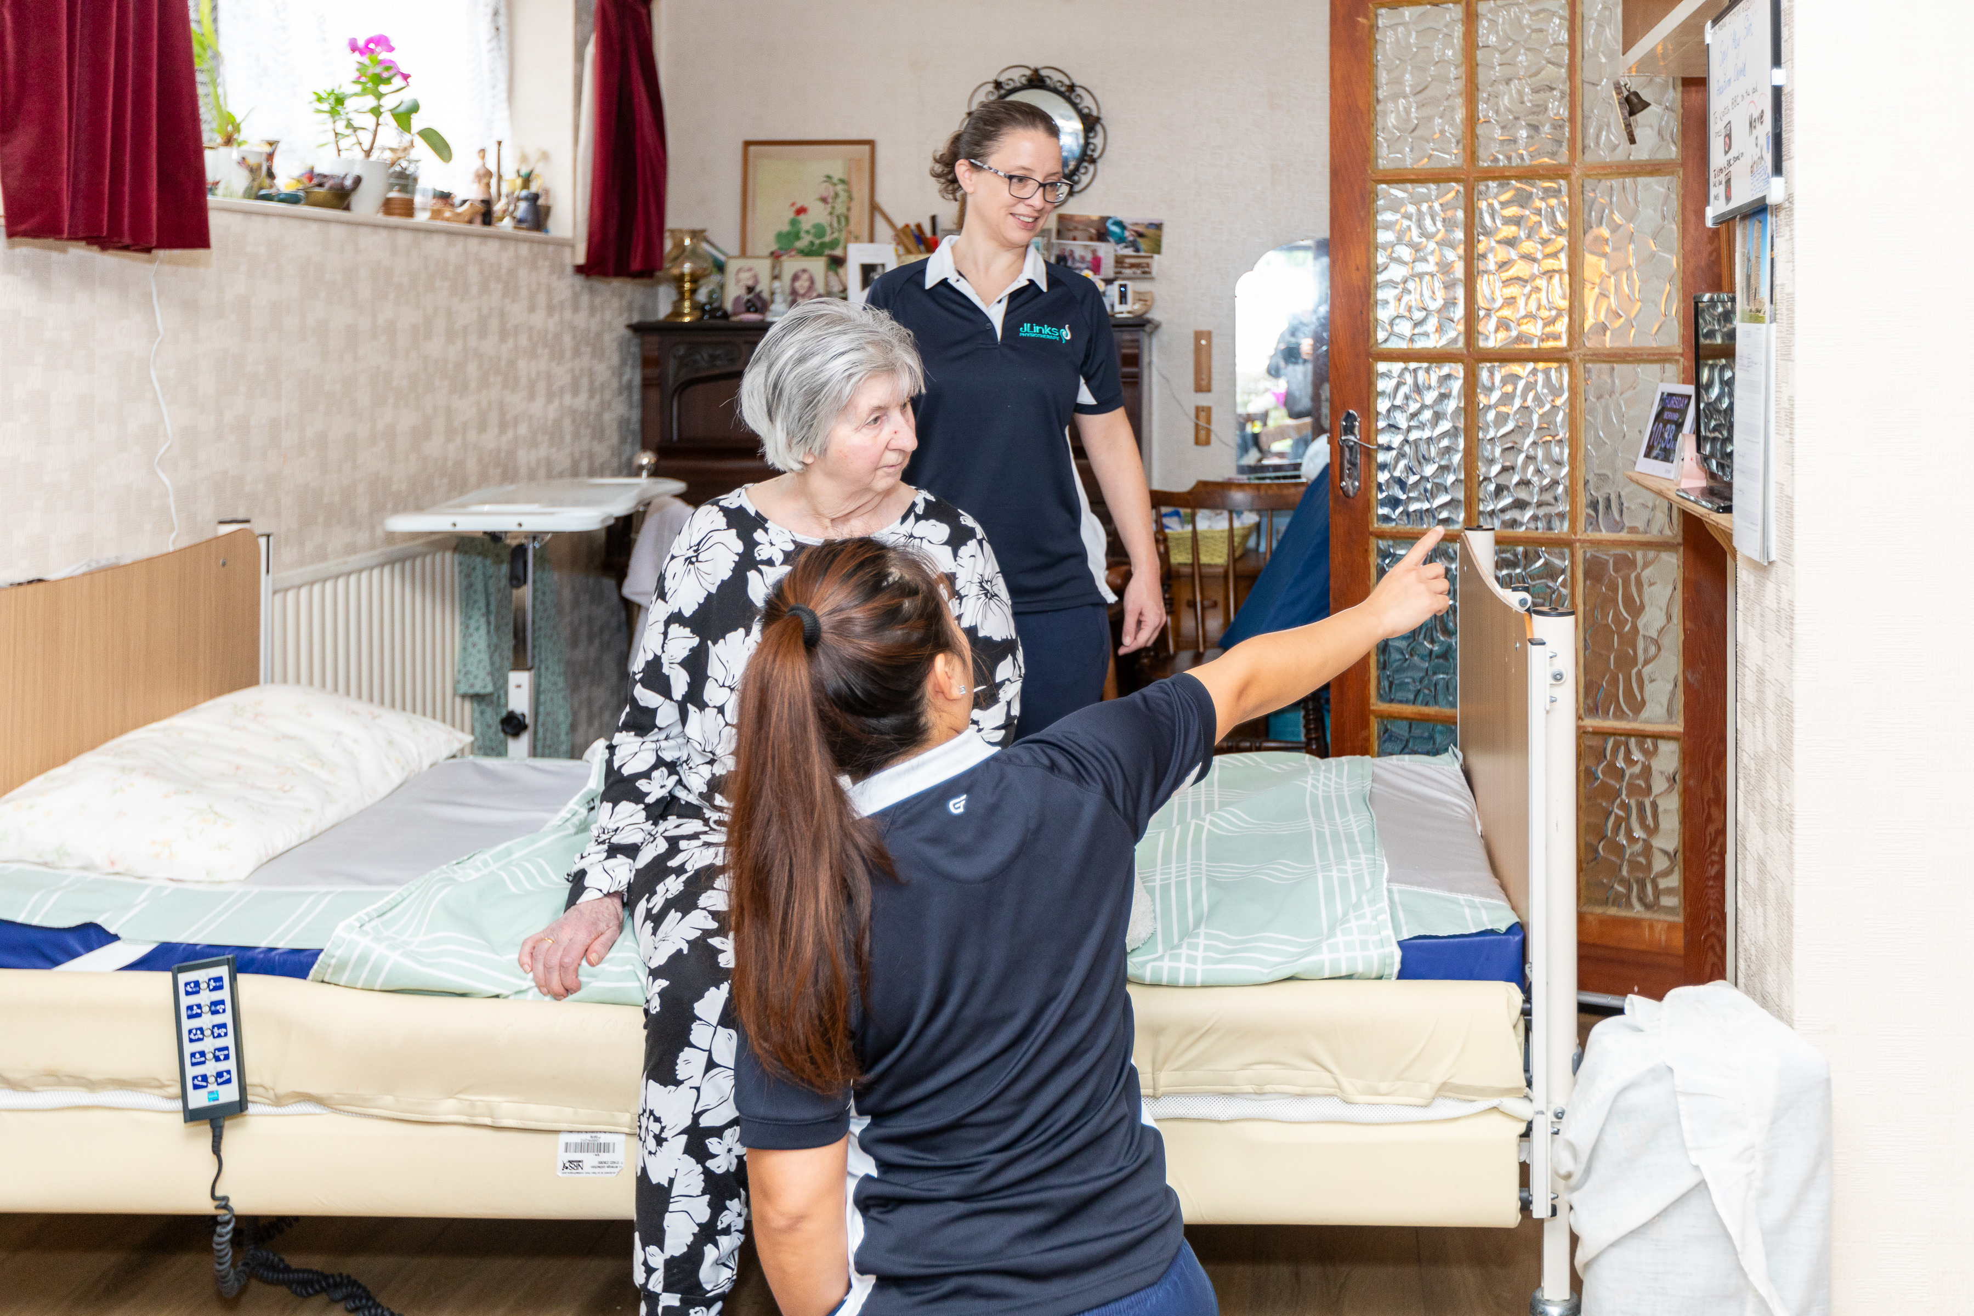
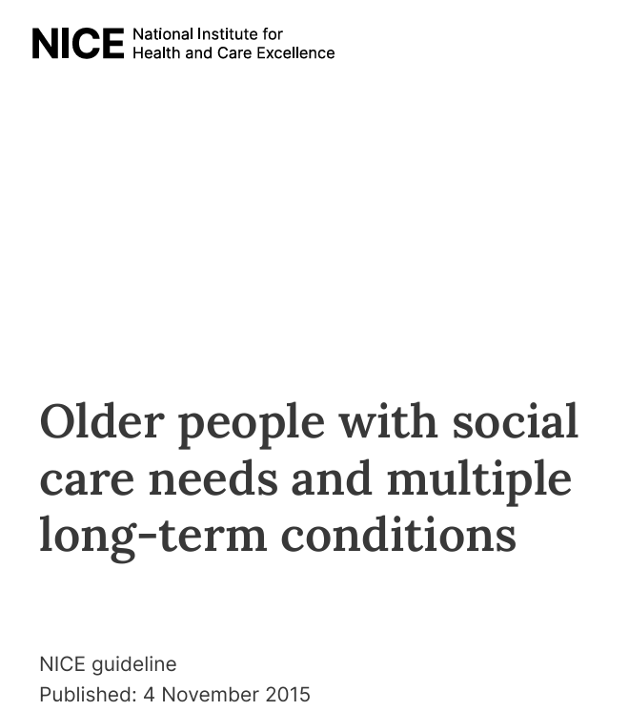
What is a LTC?
An illness that cannot be cured but can usually be controlled with medicines or other treatments
Chronic, reoccurring, & often complex, comprising more than one health issue.

Slide 17
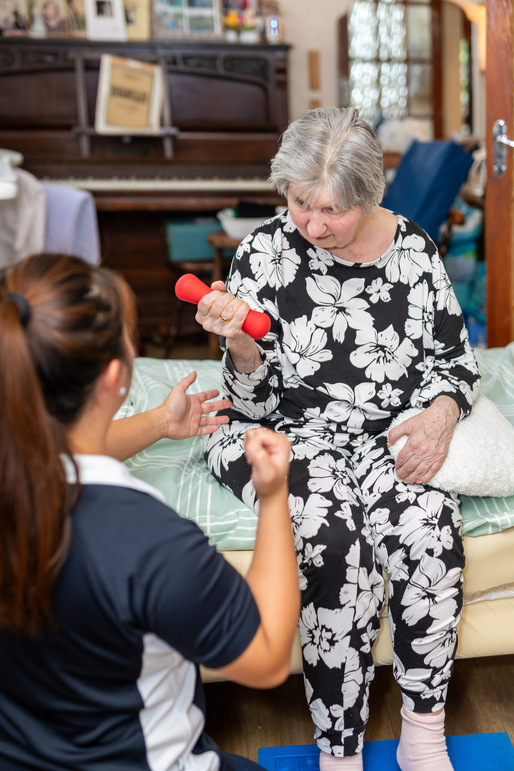
Long-term Conditions
Long term conditions are now a central task of the NHS; caring for these needs requires a partnership with patients over the longer term rather than providing single, unconnected “episodes” of care.
Aids people w/ LTCs to:
live well
age well
die well
Five Year Forward View, NHS England 2014

Slide 18
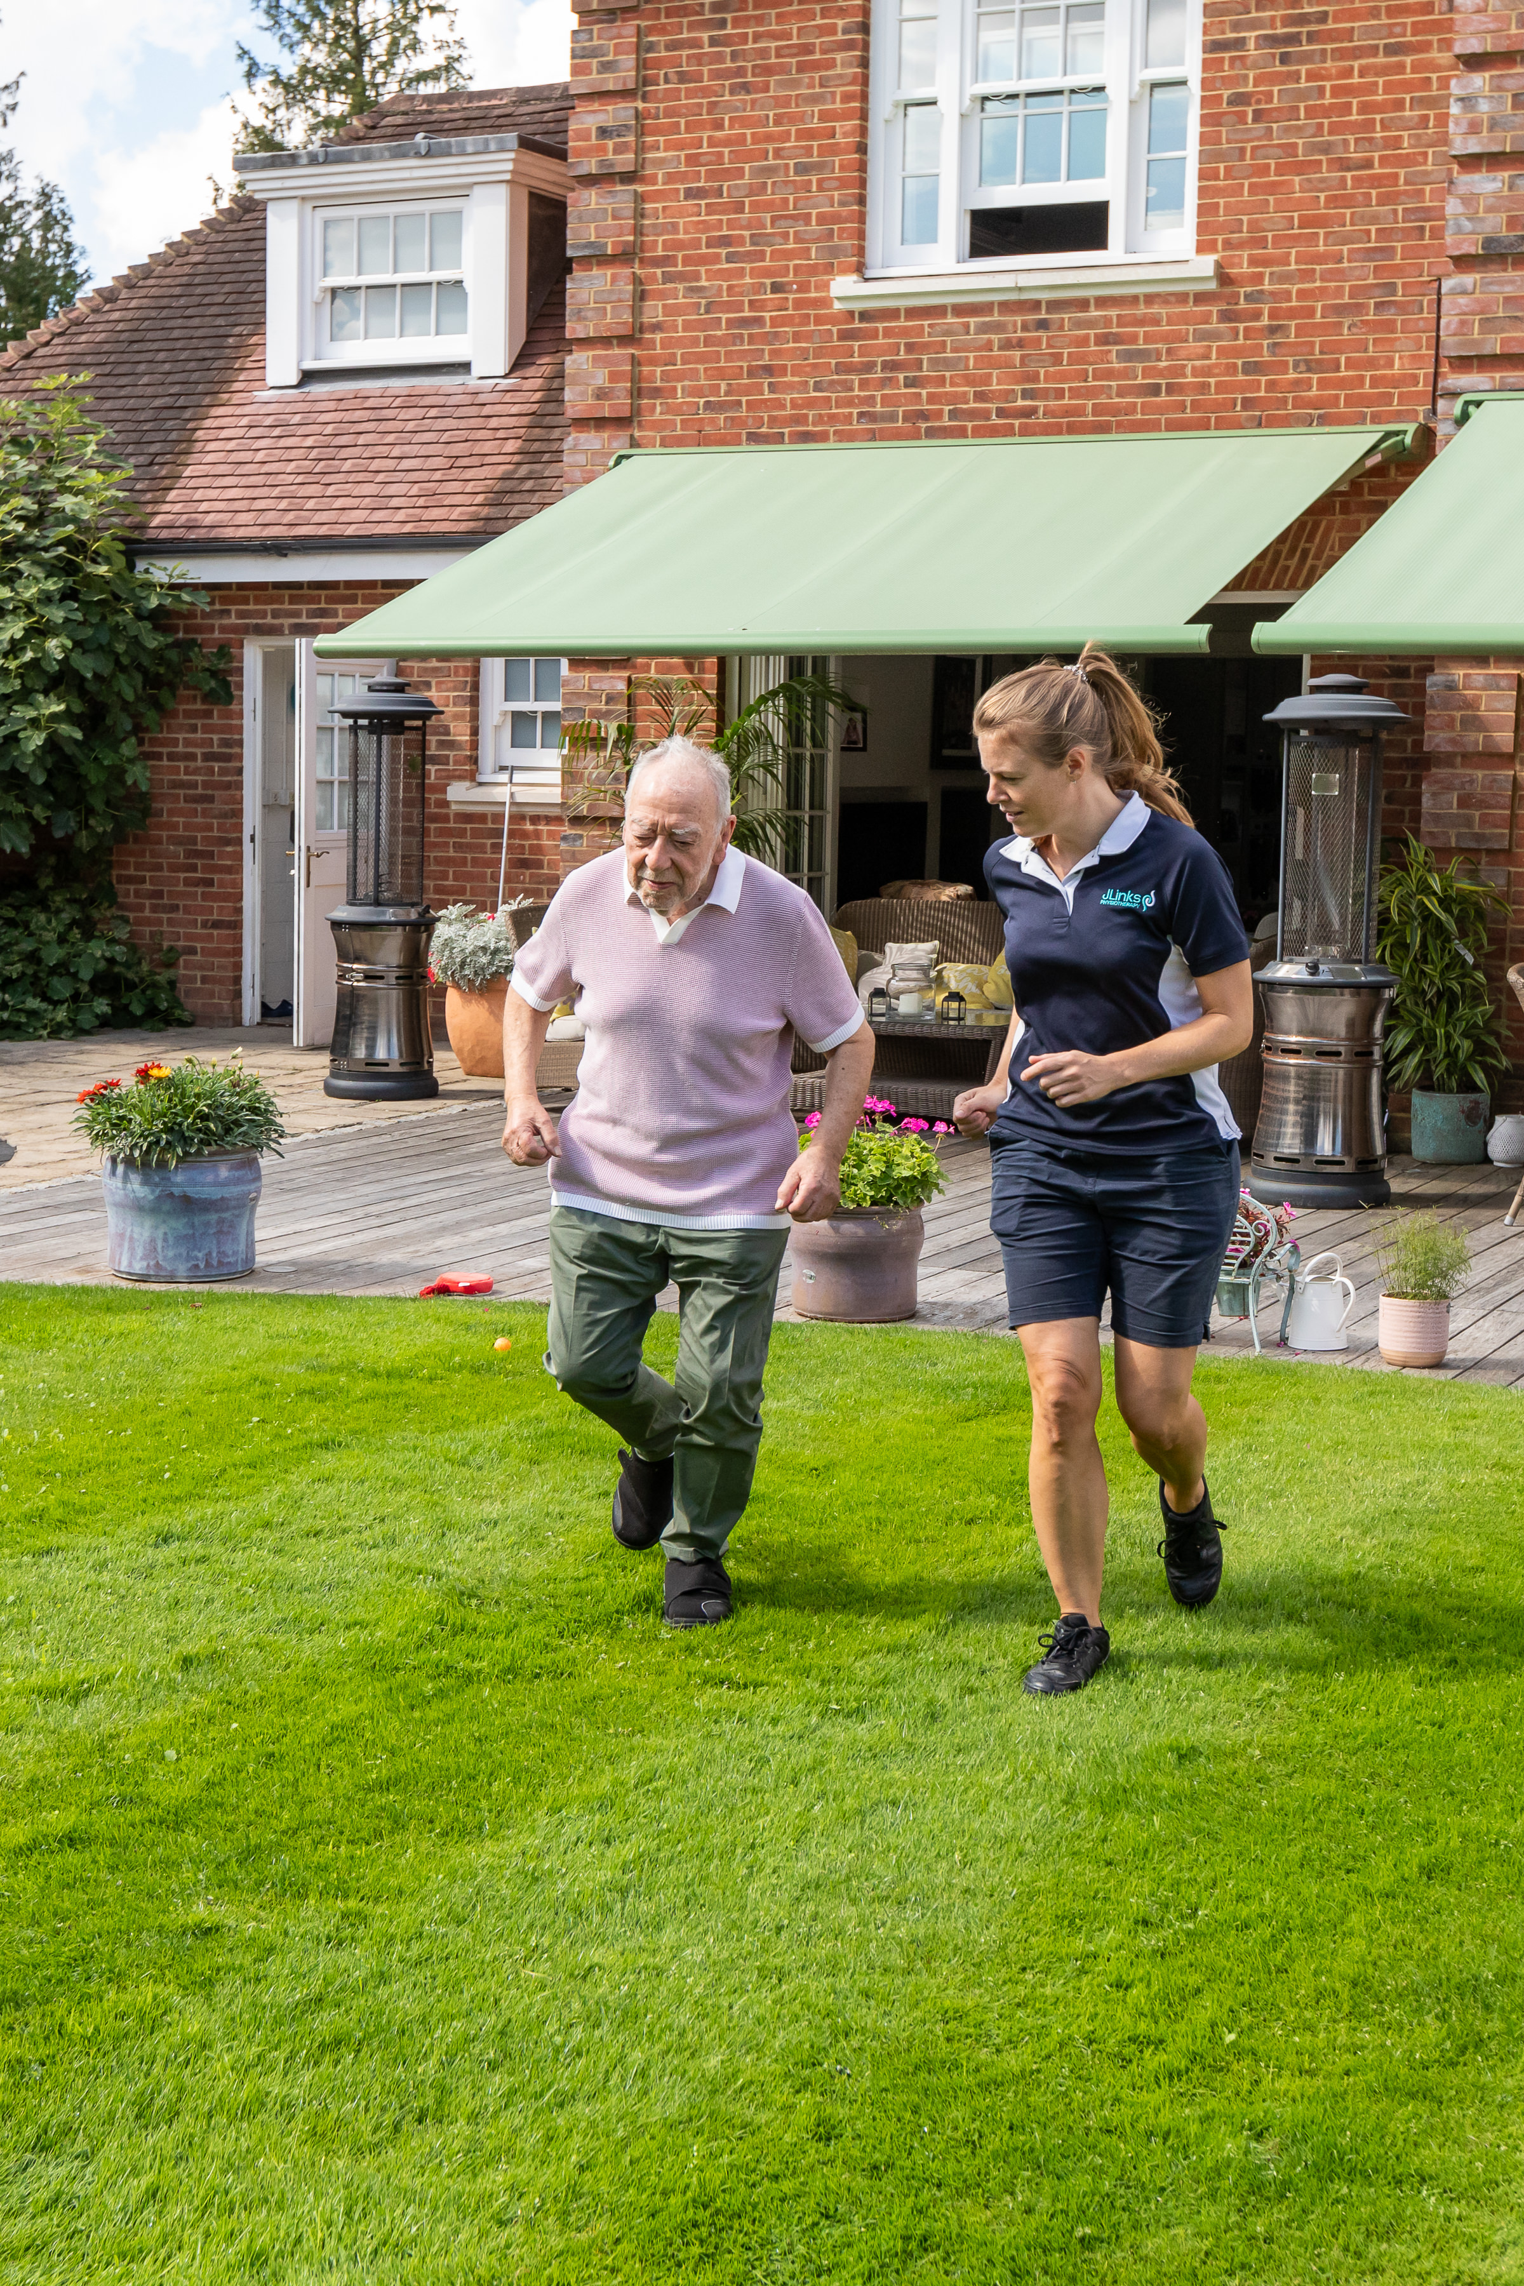
What LTCs can you think of that we might meet in the community?

Slide 19
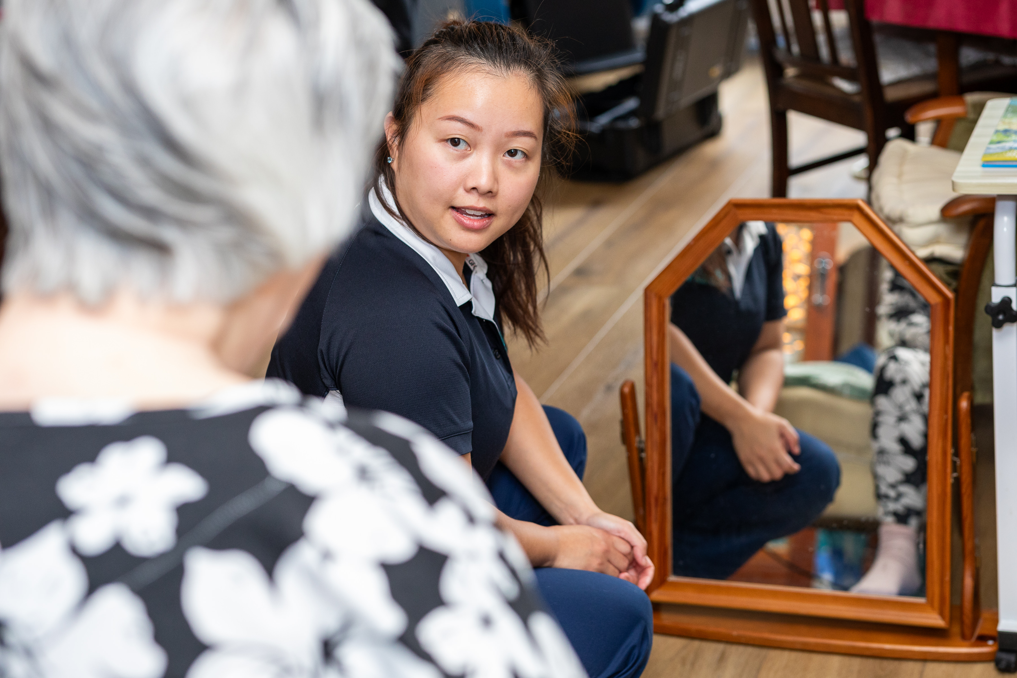
Who makes up the community MDT?

Slide 20

15:00 – 15:15

Slide 21
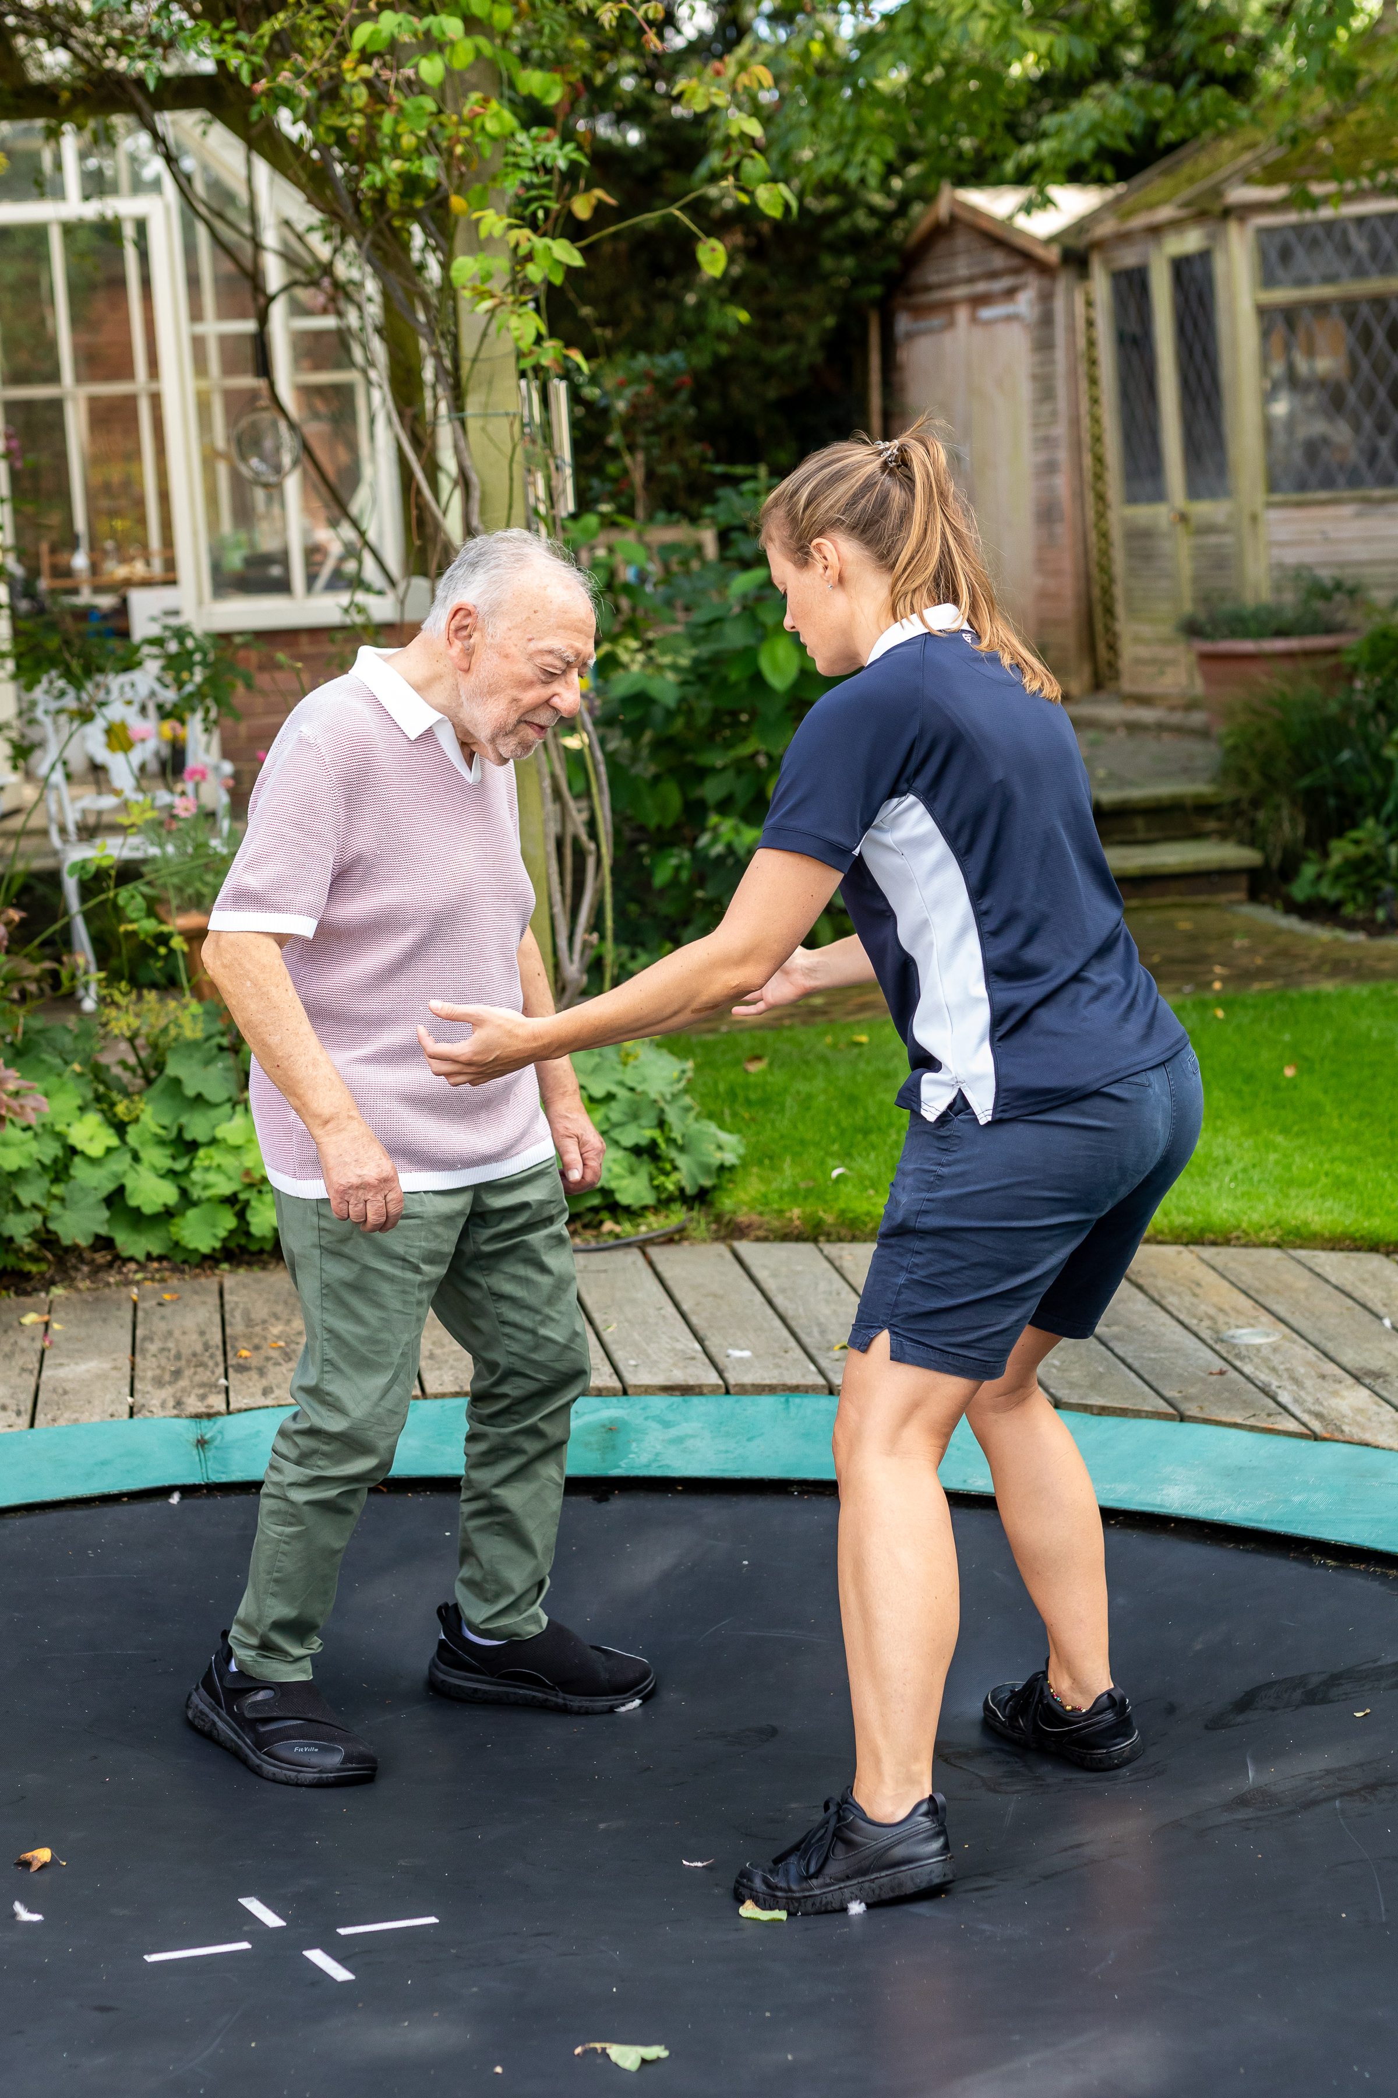
Practical – library
What do we need to assess? (subj & obj)
What is our problem list (listed by priority)?
What do we need to treat?
Do we need to refer to anyone else in the MDT? Who?
30 mins to come up w/ list in your groups, ready to feed back as a larger group at 16:30.

Slide 22
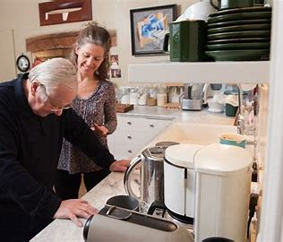
Practical – flat
Demo scenarios in different rooms.
5 mins smaller groups, then demonstrate to larger groups x5.
30 mins total.

Slide 23
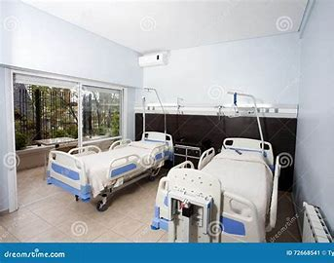
Practical – library
Case 1:
Patient: 90 F, D/C to BBR after 1/12 hosp adm after R TKR complications (pain, found to have fractured patella, needed revision + HKB (currently 0-90 degrees)). Currently mobile w/ WZF indoors. Wants to get back to ind living.
PMH: OA, R elective TKR 3/12 ago, HTN, Hypercholesterolaemia, DM T2.

Slide 24
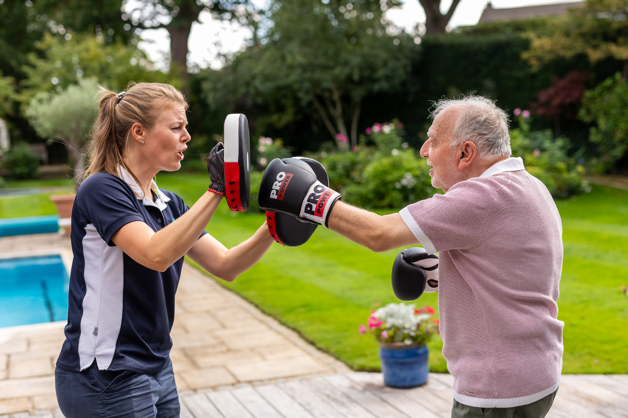
Practical – library
Case 2:
Patient: 83 M, m&I, would like advice on how to Mx recent PD diagnosis & reduce falls risk.
PMH: Spinal Stenosis, spinal op, PD, urinary urgency.

Slide 25
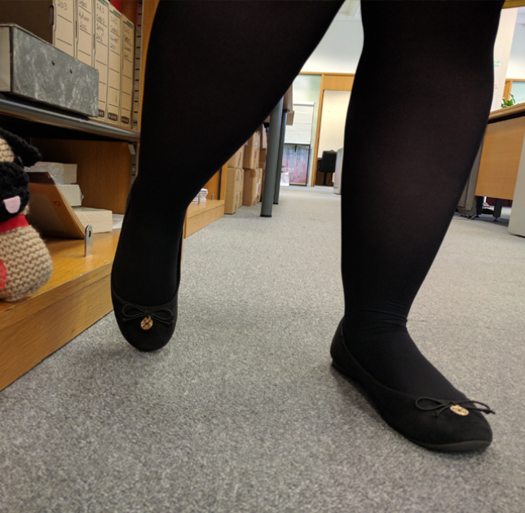
Practical – library
Case 3:
Patient: 25 F, m&I but dragging RLL, presented to ED as ? CES, now just diagnosed with MS, trainee solicitor currently unable to work, Neurologist recommended physio.
PMH: PCOS, constipation.

Slide 26
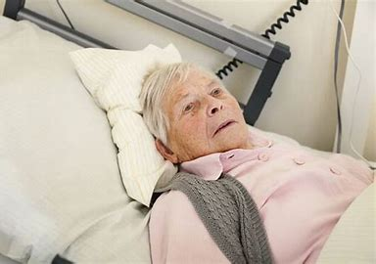
Practical – library
Case 4:
Patient: 83 F, in NH, Advanced Dementia, no longer mobilising with carers, using hoist, family would like to know “rehab pot” .
PMH: Dementia diagnosed 2018, OA neck.

Slide 27
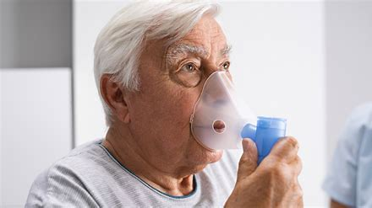
Practical – library
Case 5:
Patient: 83 M just D/C from 6/52 hospital admission post fall/collapse, treated for IECOPD & postural hypotension. Struggling to get to toilet, struggling to stand with wife & daughter helping w/ quad stick, family acopic – GP referral.
PMH: COPD, AF, HTN, Stroke, Ex smoker.

Slide 28
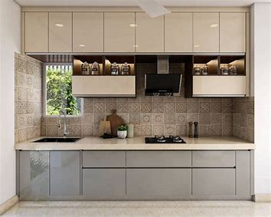
Practical - flat
Case 1:
Demonstrate how you would teach moderate level dynamic standing balance exercises to a 75-year-old female within 6/52 following a right hip fracture (DHS – FWB). Currently mobile w/ L w/s indoors.
PMH: OP, ex-ETOH excess.

Slide 29
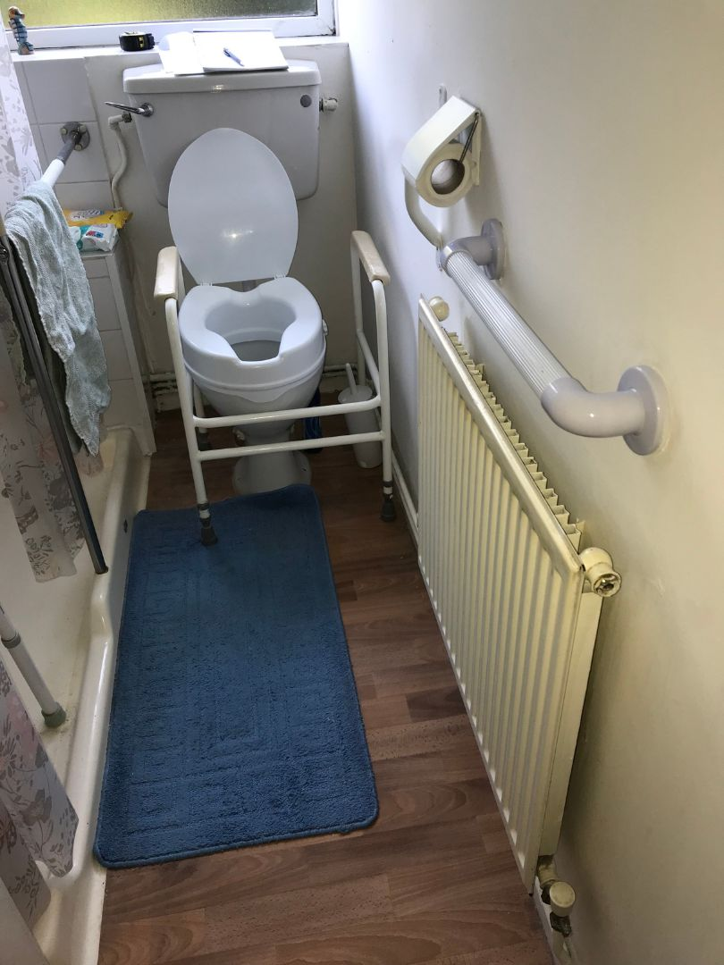
Practical - flat
Case 2:
Demonstrate how you would manage when finding an 86 M collapsed by the toilet.
PMH: PD, R hip fracture – DHS 1.5 years ago.

Slide 30
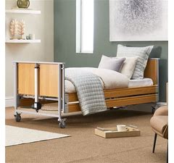
Practical - flat
Case 3:
Demonstrate how you would work on static then dynamic sitting balance with a 55 year old M 12/52 post stroke.
PMH: Stroke LSW, HTN, Hypercholesterolaemia, incr BMI.

Slide 31

Practical - flat
Case 4:
Demonstrate how you would assess lower limb ROM & strength in 71 M 2/52 post elective R TKR (FWB).
PMH: OA.

Slide 32
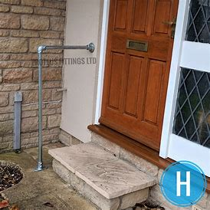
Practical - flat
Case 5:
Demonstrate how you would facilitate outdoor mobility in 92 F, currently housebound post hosp adm for pneumonia & covid, to return to mob to local corner shop 500m away. Lives alone in bungalow w/ 2 access steps.
PMH: Asthma, fractured L wrist 20 years ago, hysterectomy 30 years ago.

Slide 33


Closing 16:30–17:00
Final reflections
Feedback

